Slide 1
Plan for today
Fitting DoG to RFs
Color RFs findings:
a) Directly looking at color RFs is unreliable: few examples
b) Clusters and their mosaics: no –S cluster, but cluster for OFF Parvo + -S inputs instead.
c) S inputs have larger centers, and therefore weaker surrounds
Reducing LR at plateau

Slide 2
Fitting DoGs to RFs

Slide 3
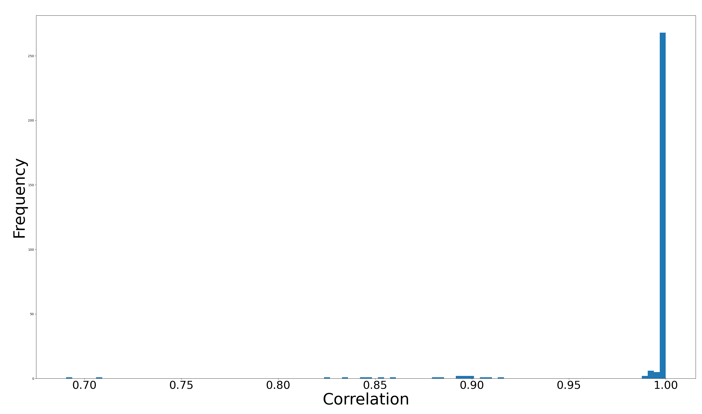
DoG fit to parametrized RFs

Slide 4
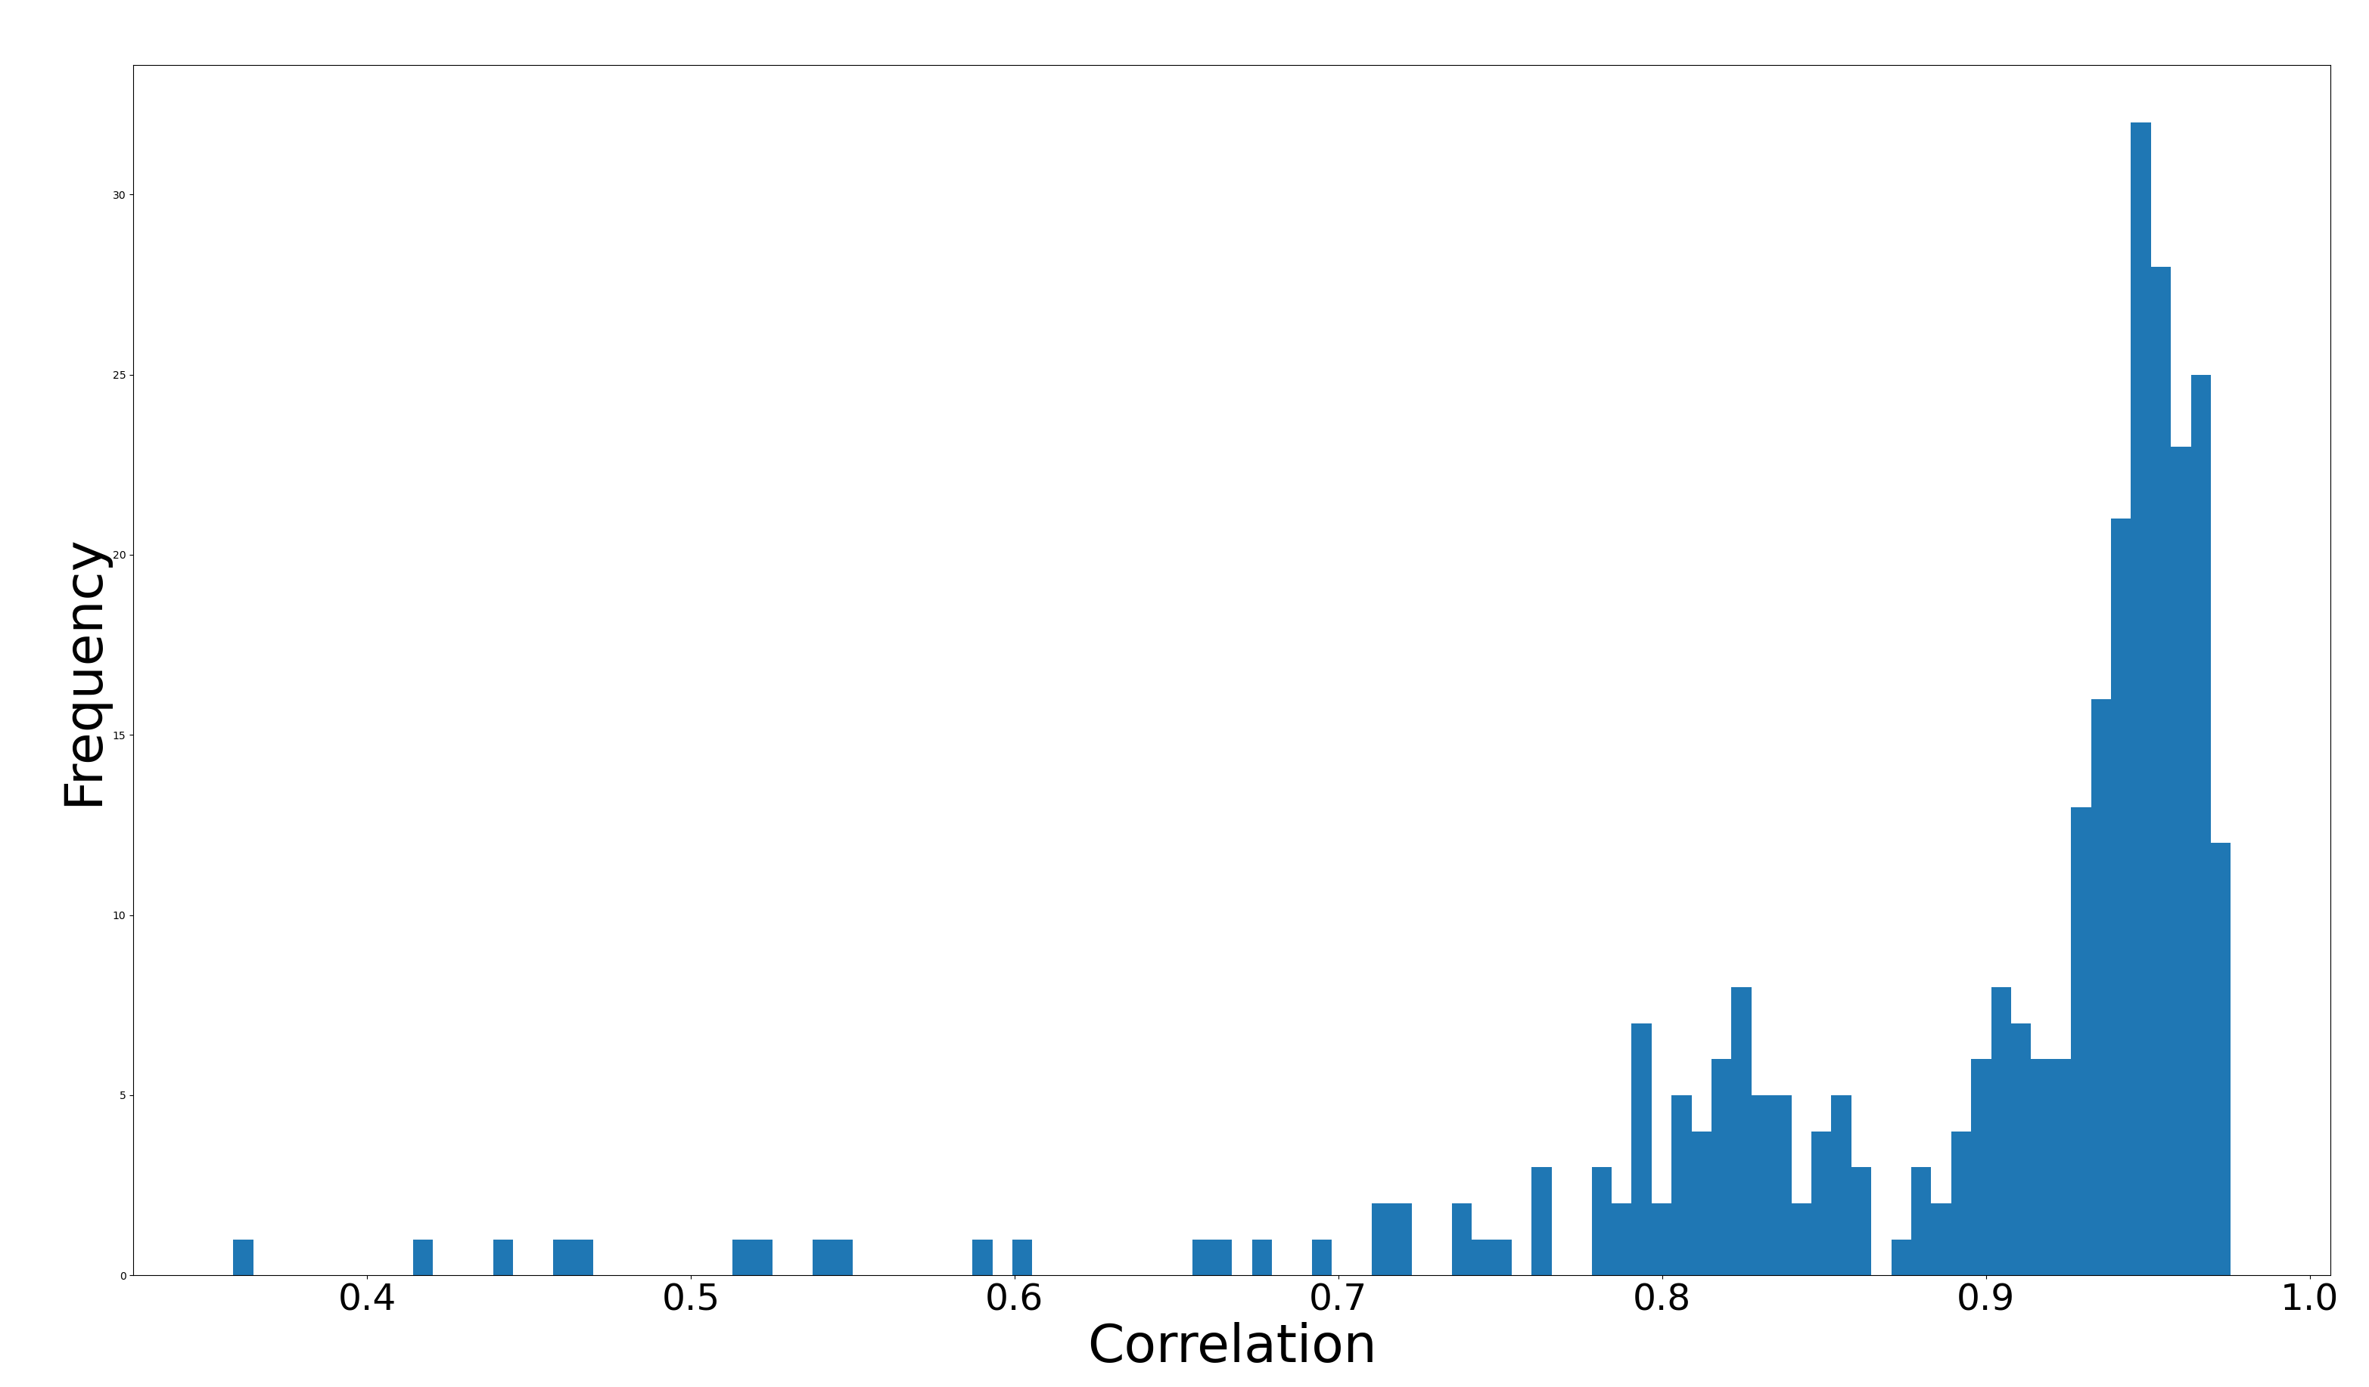
DoG fit to unparametrized RFs

Slide 5
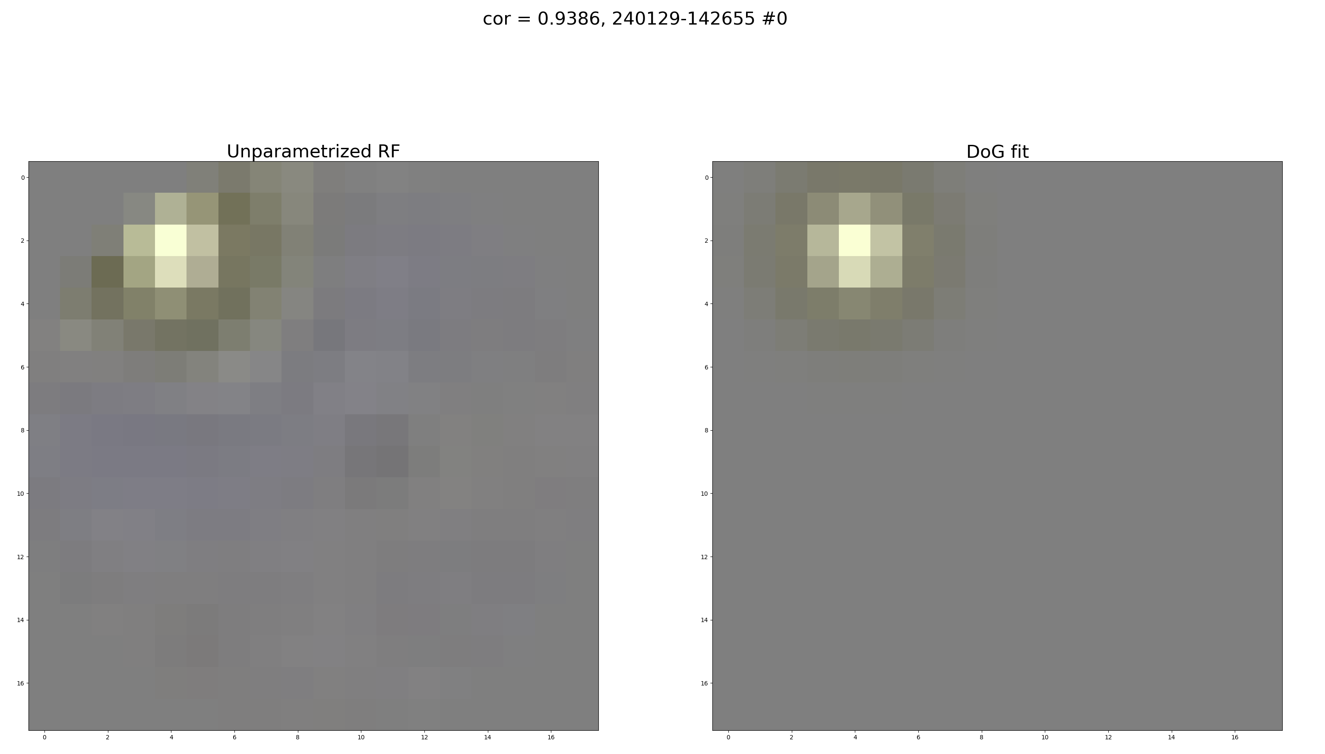

Slide 6
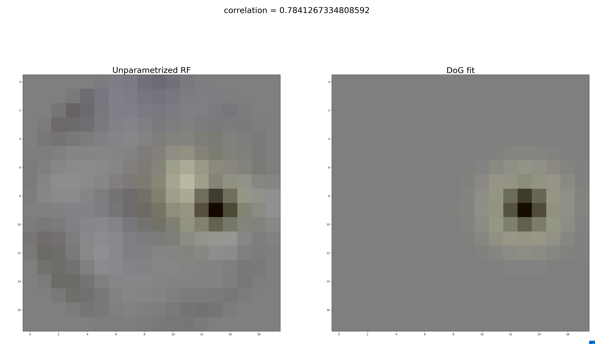

Slide 7
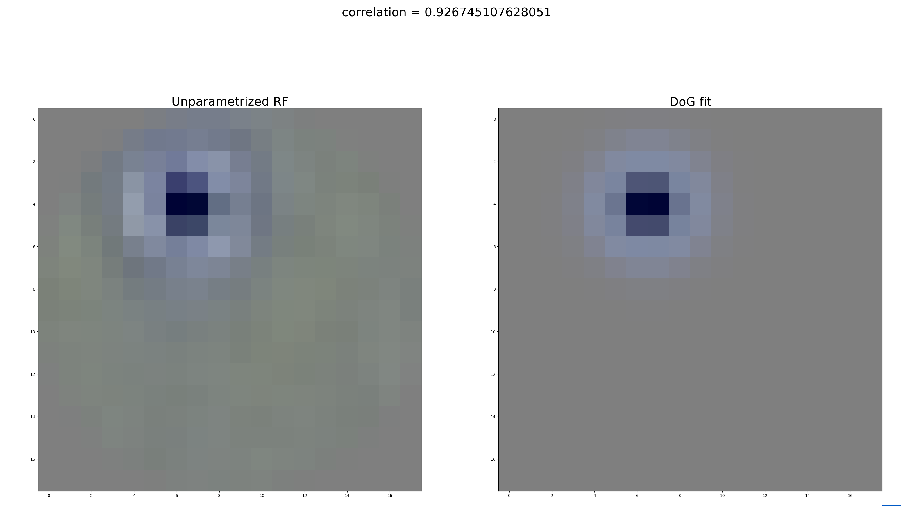

Slide 8
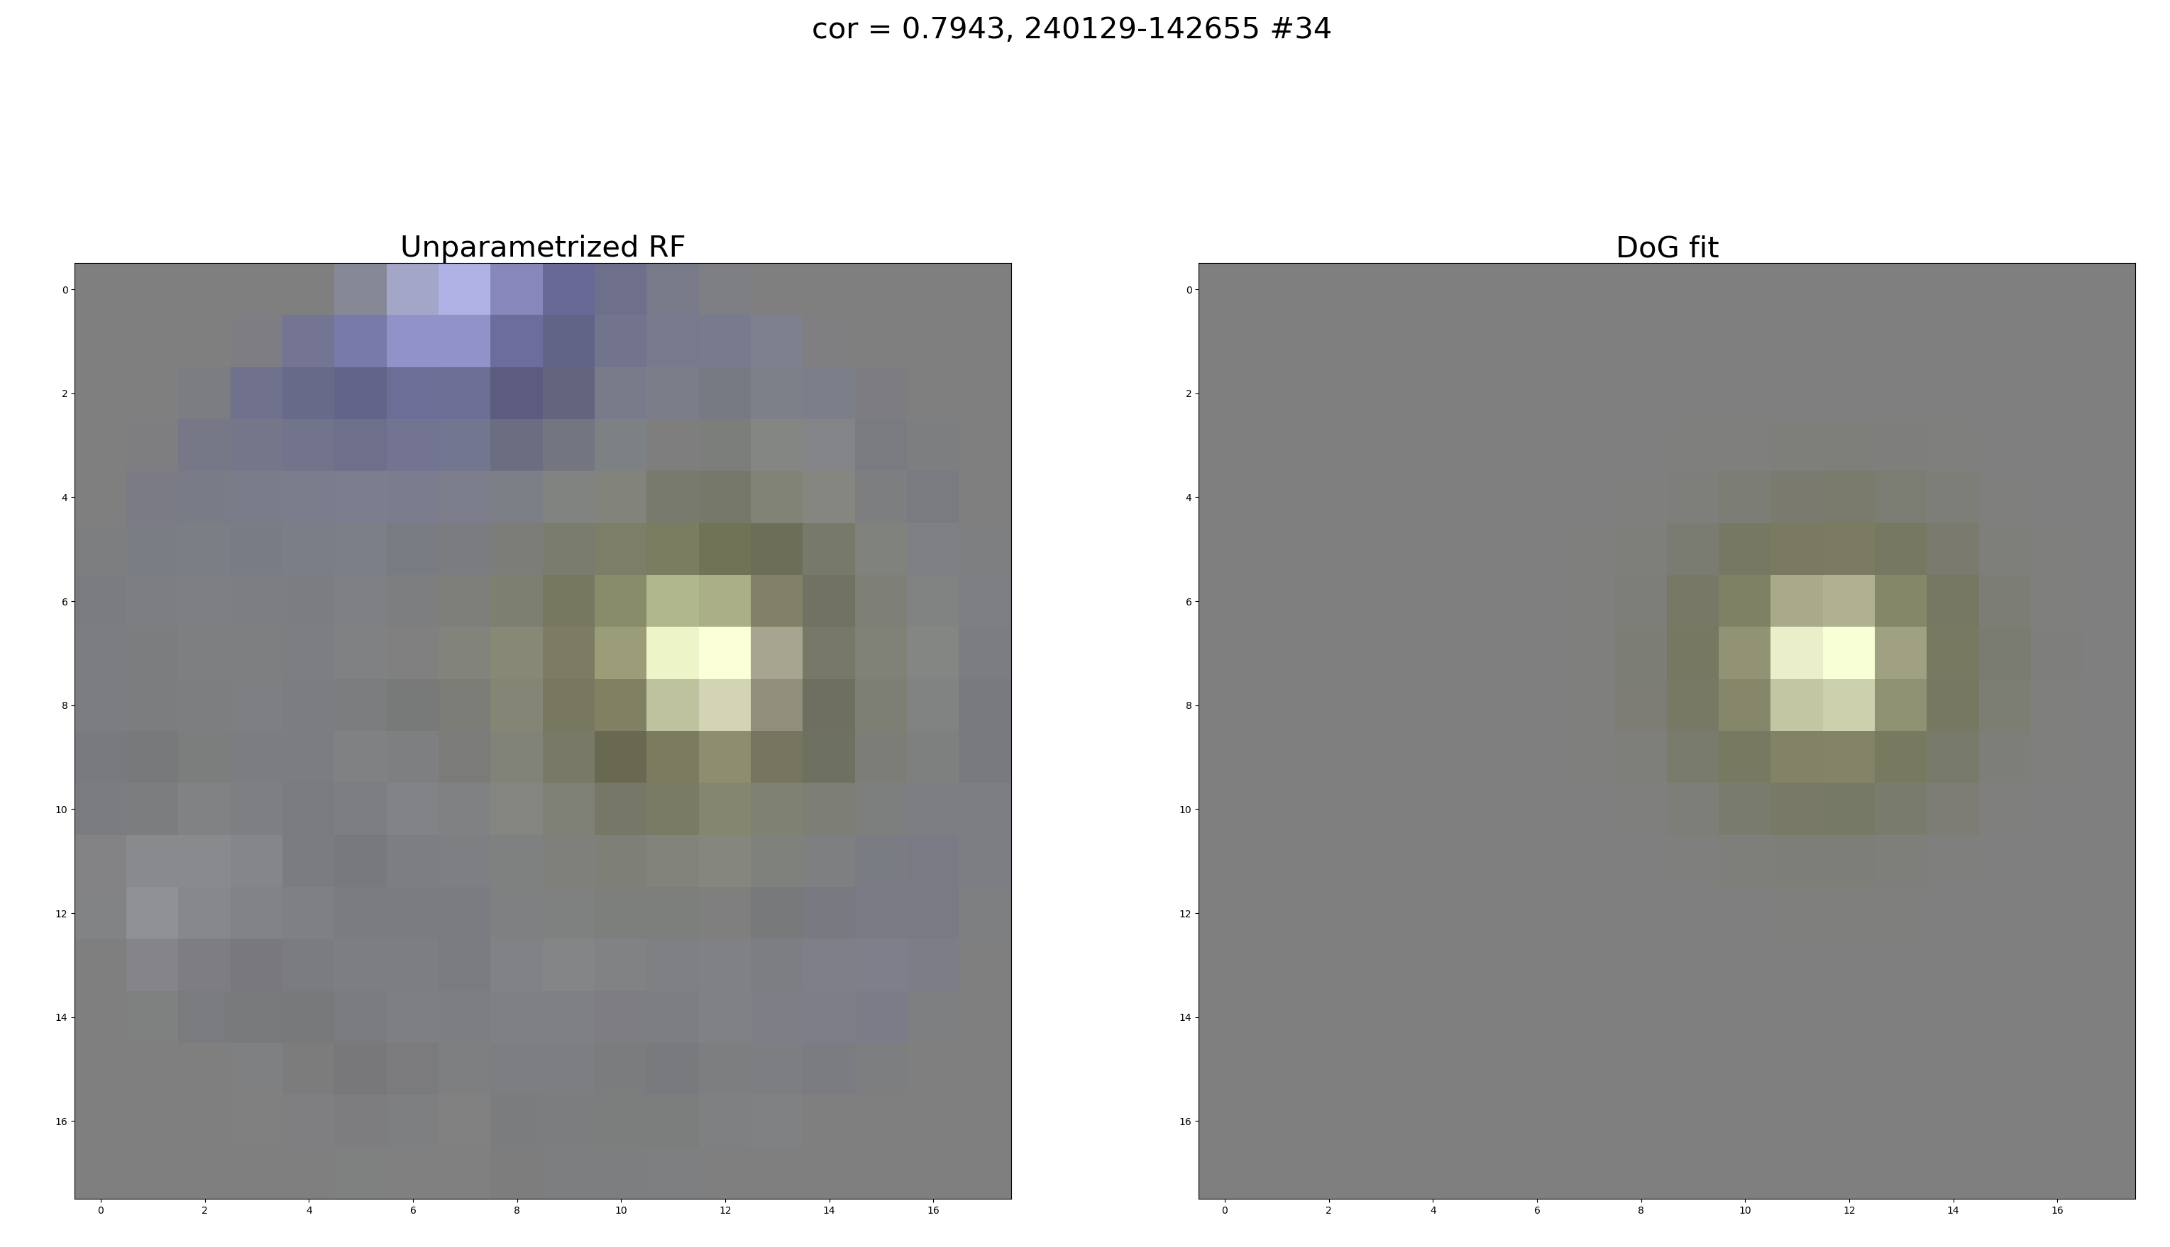

Slide 9
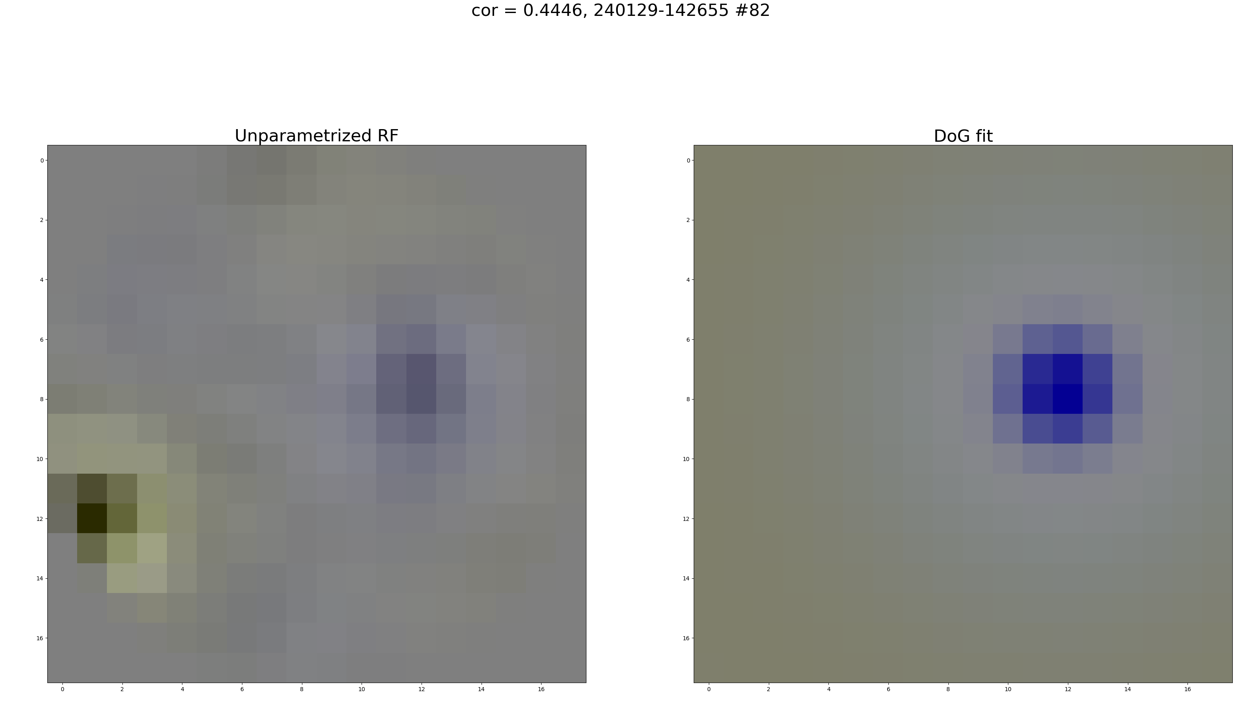

Slide 10
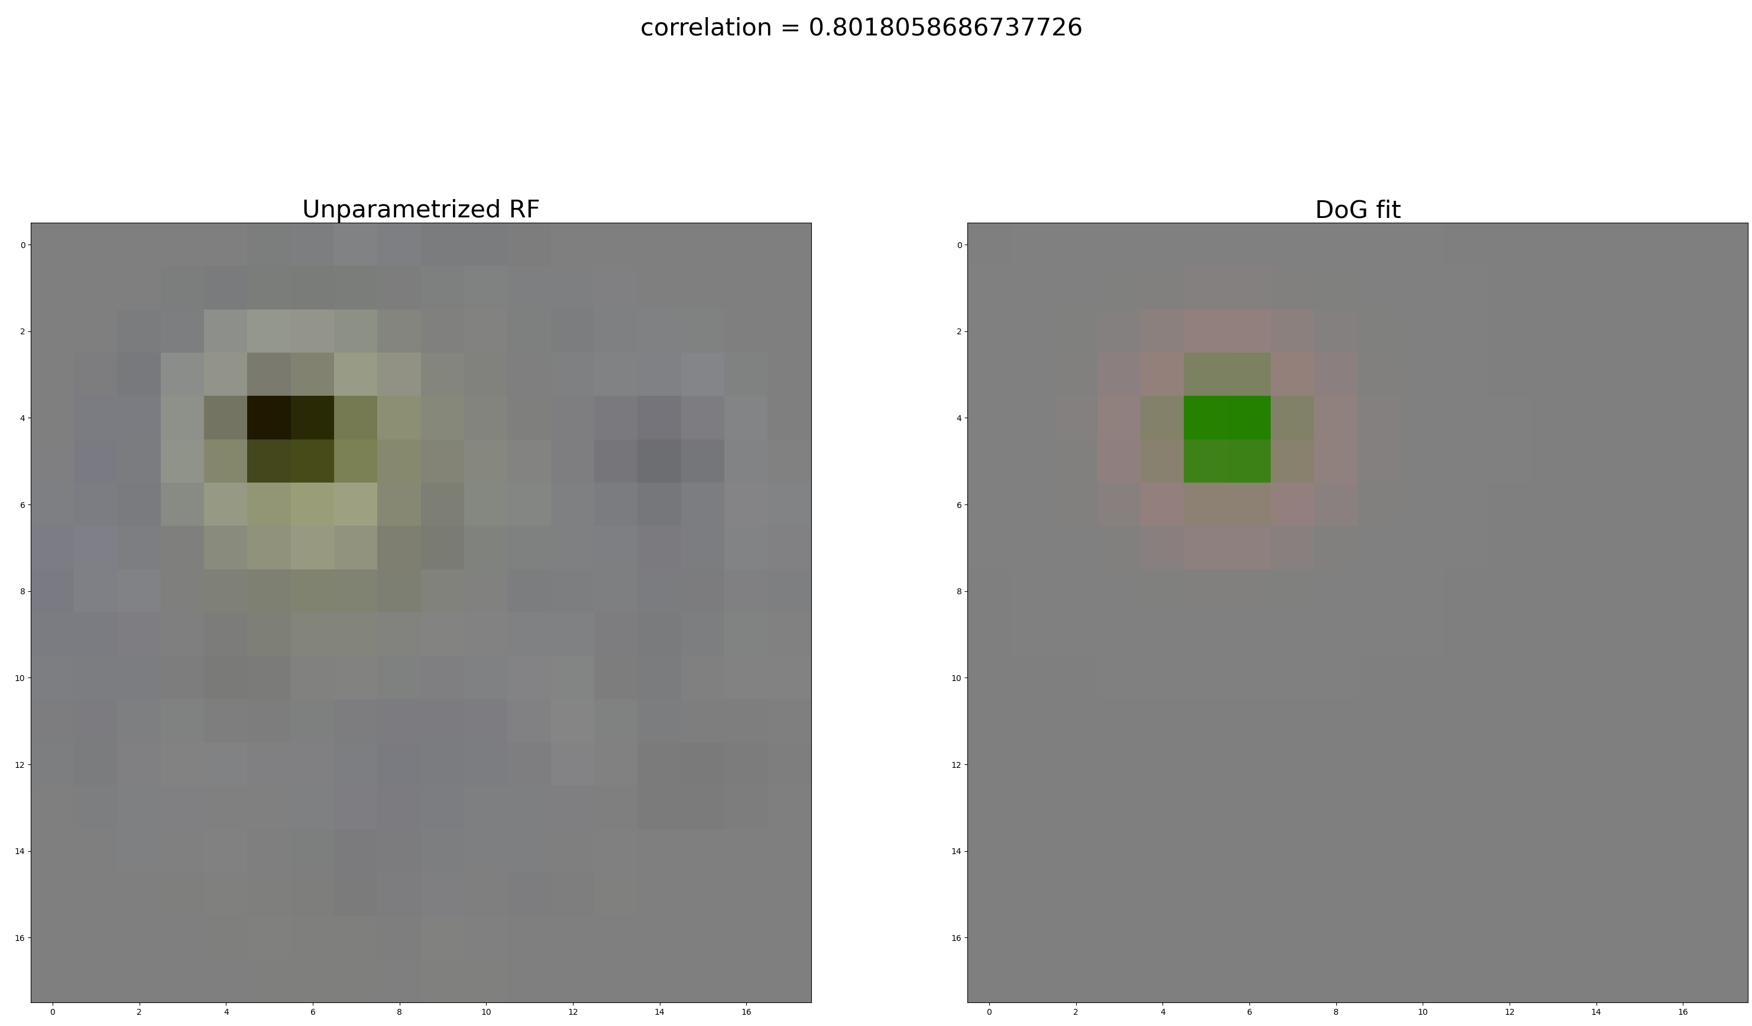

Slide 11
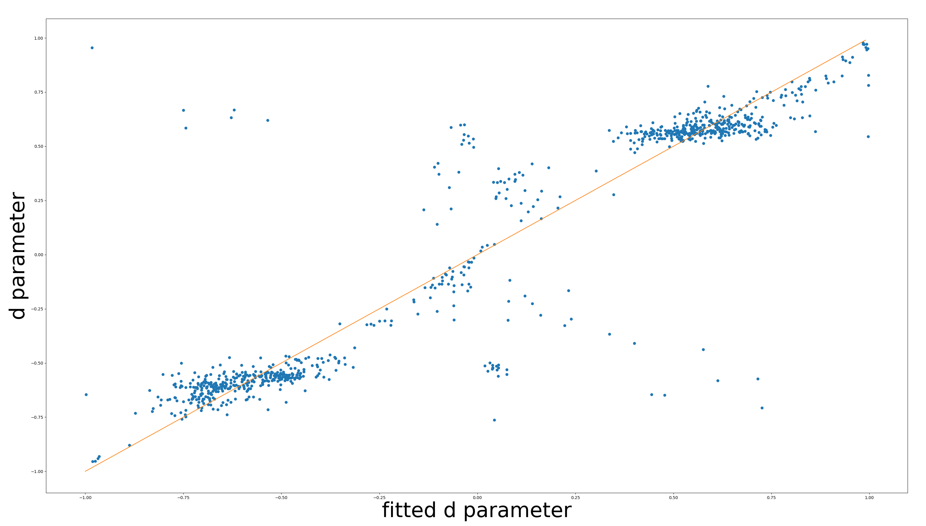

Slide 12
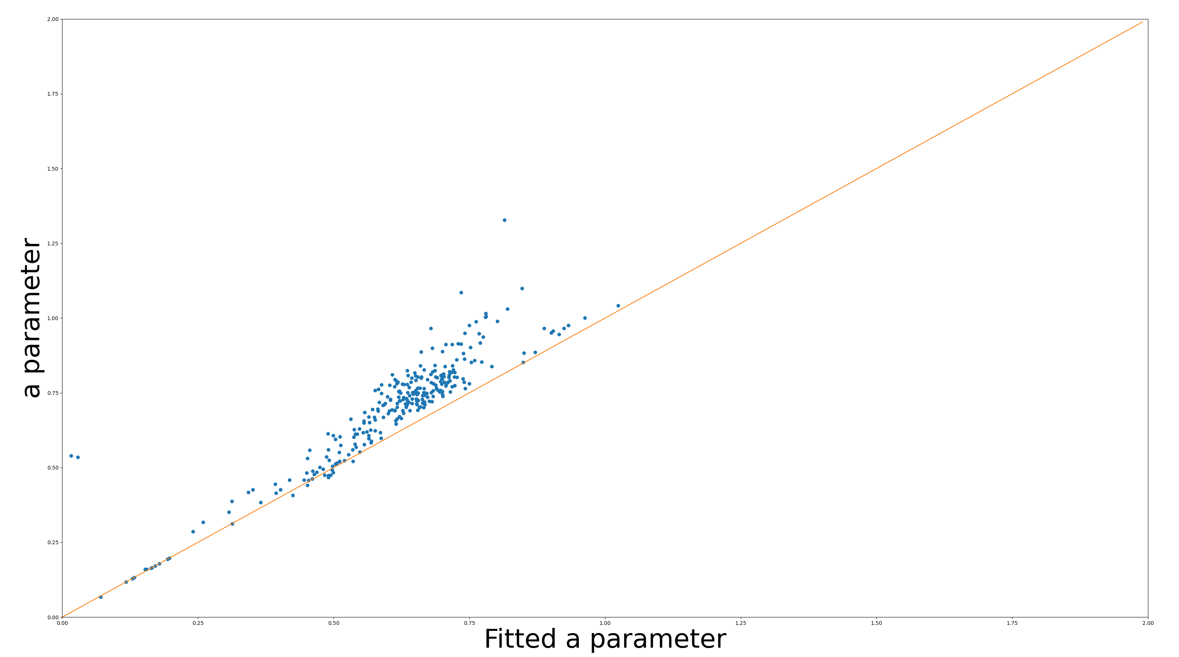
Only the most important channel

Slide 13
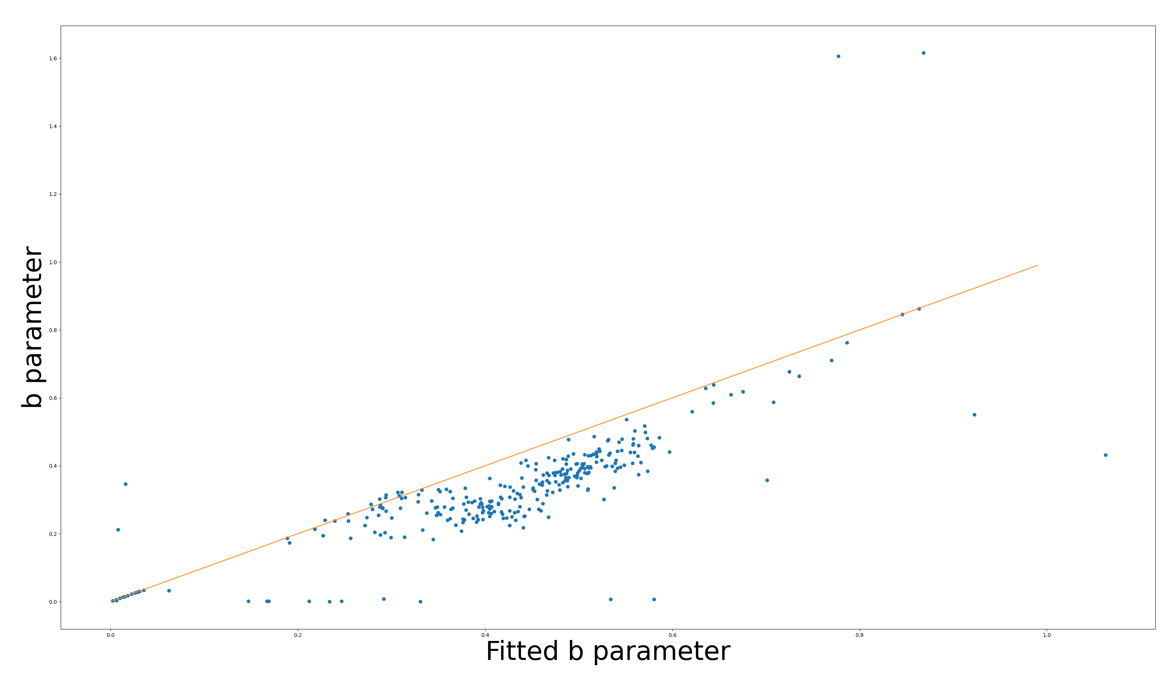
Only the most important channel

Slide 14
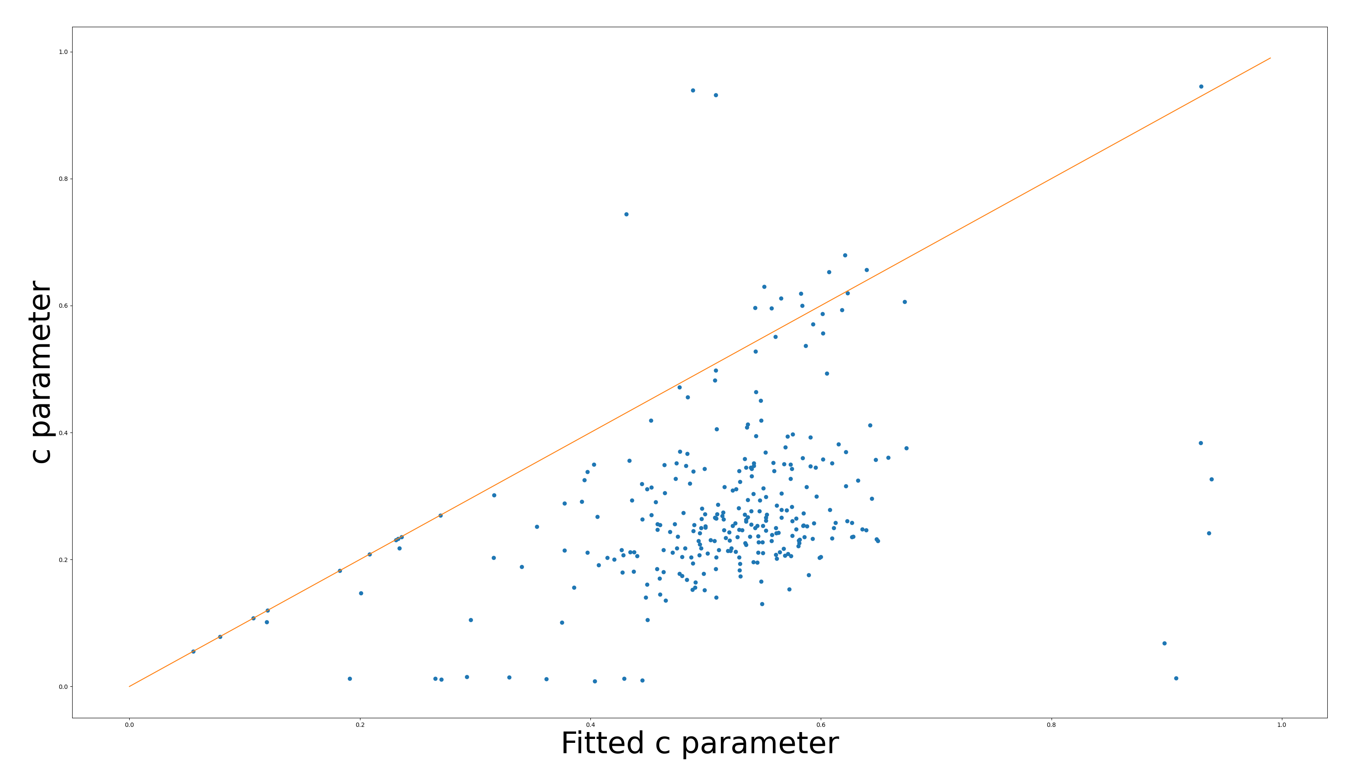
Only the most important channel

Slide 15
Color RFs
Directly looking at color RFs is unreliable
Near absence of –S RFs
S inputs have much weaker surrounds

Slide 16
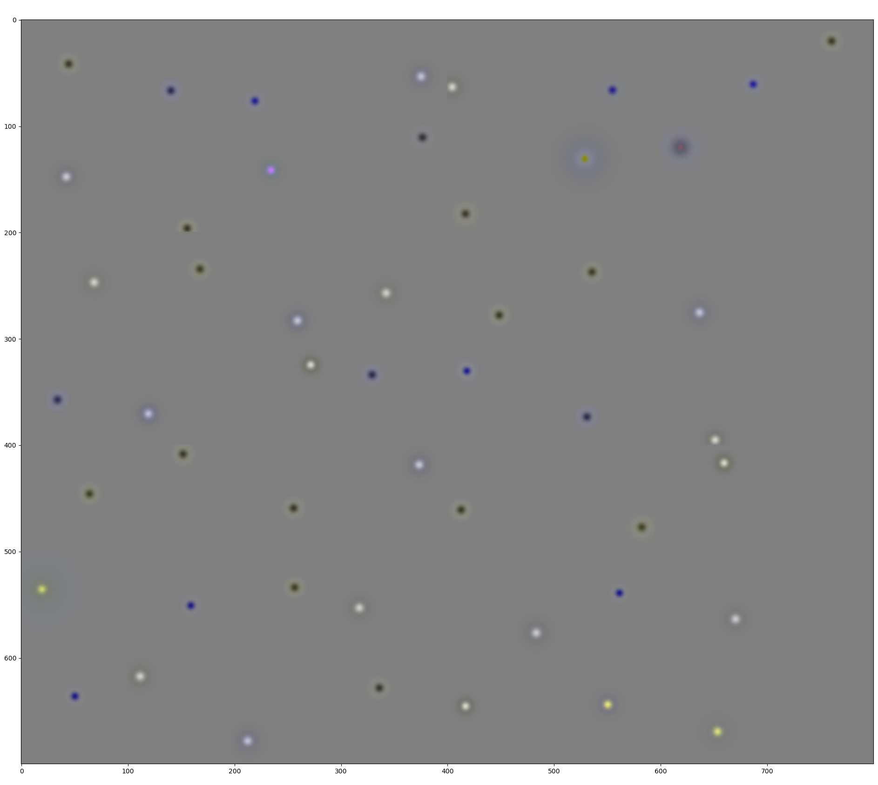
Looking at colors is unreliable

Slide 17
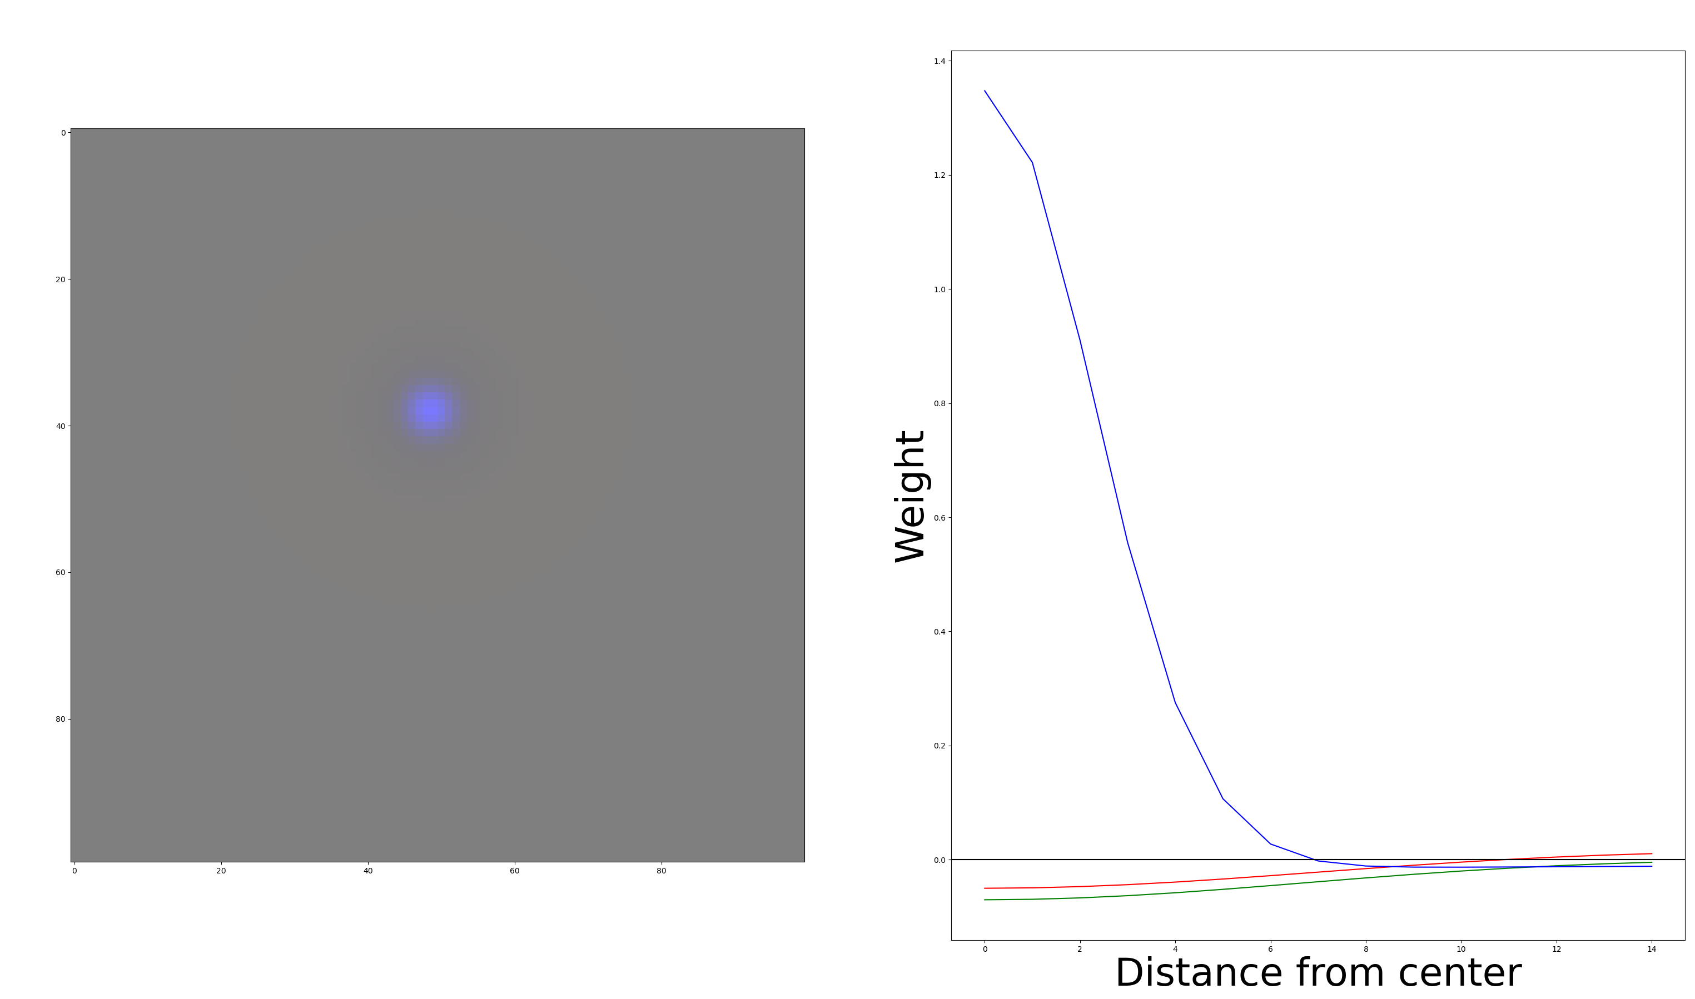
That’s what you would expect a “blue” RF to look like:

Slide 18
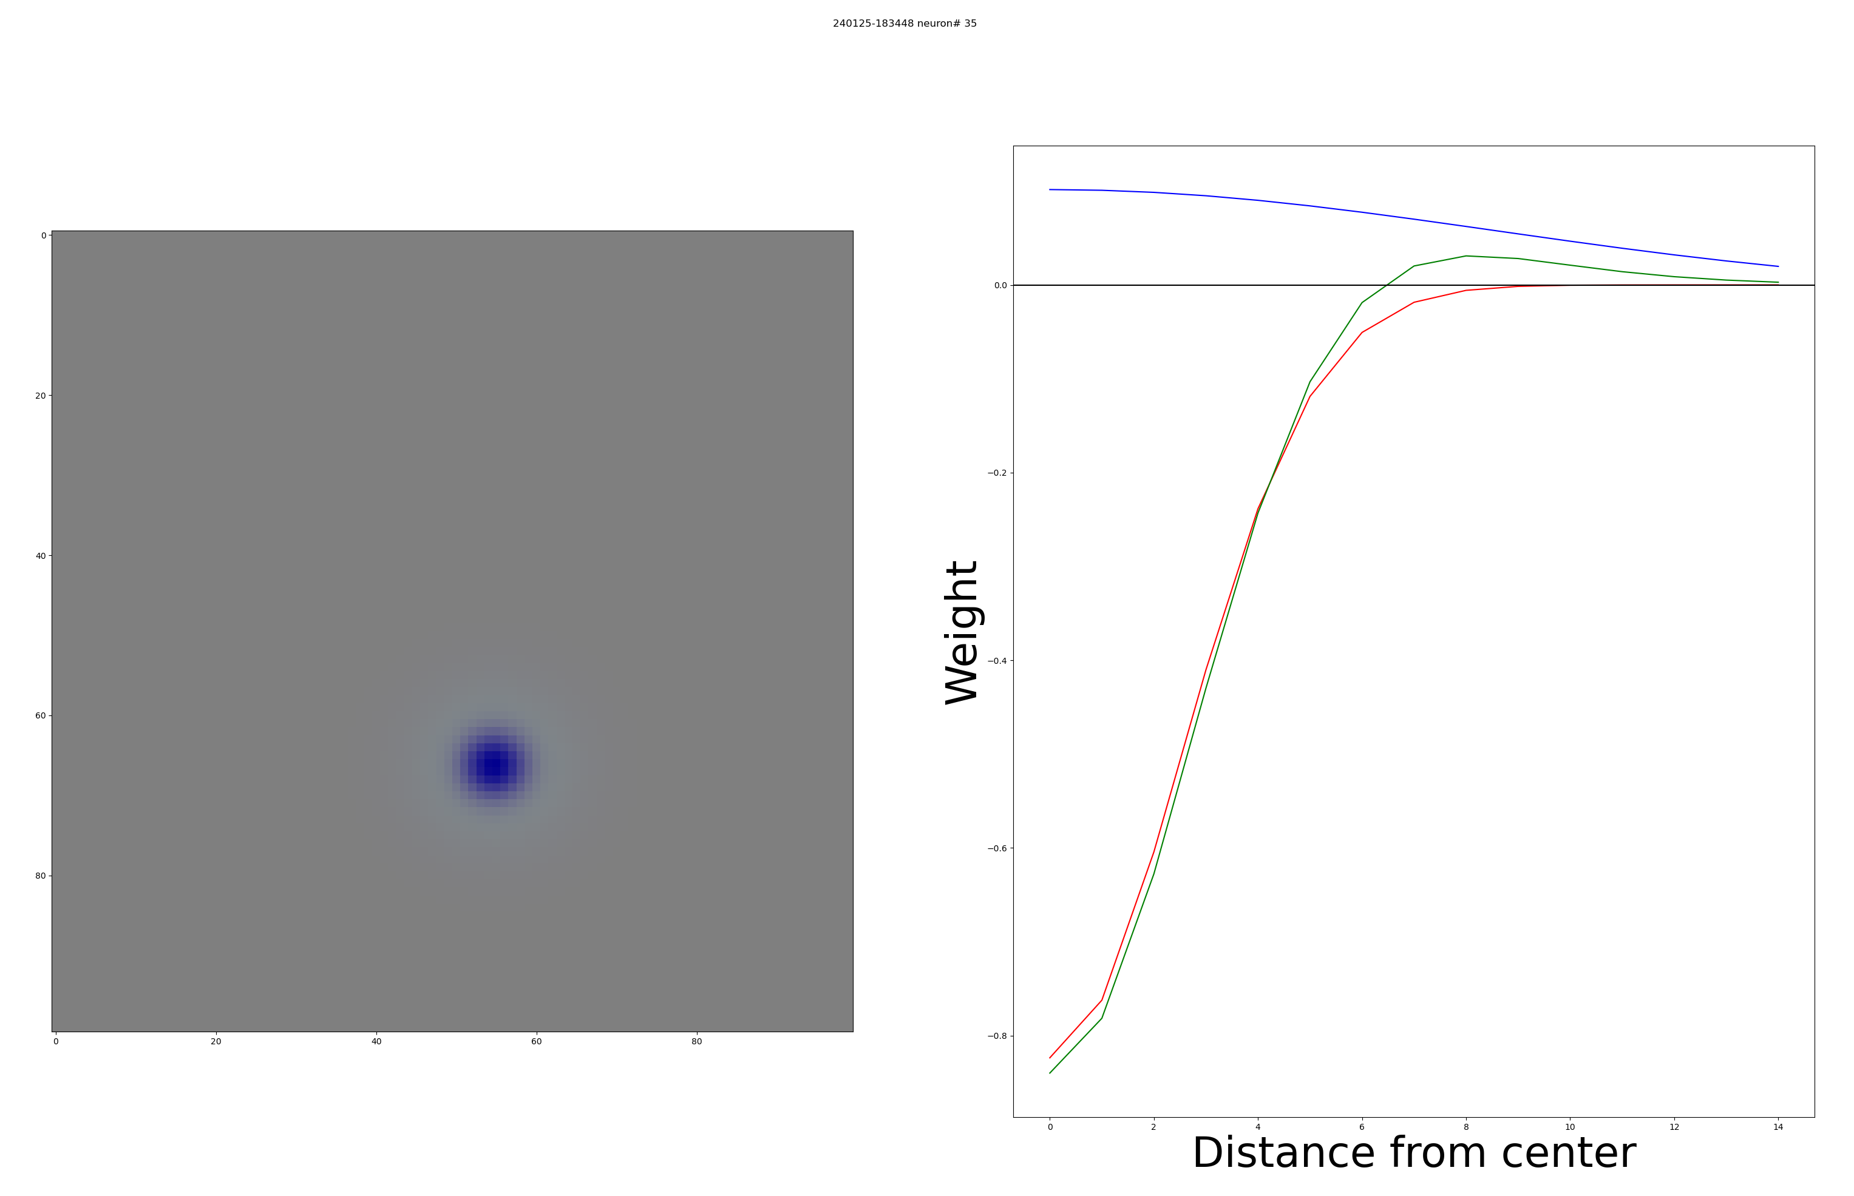
But most “blue” RFs look like this:

Slide 19
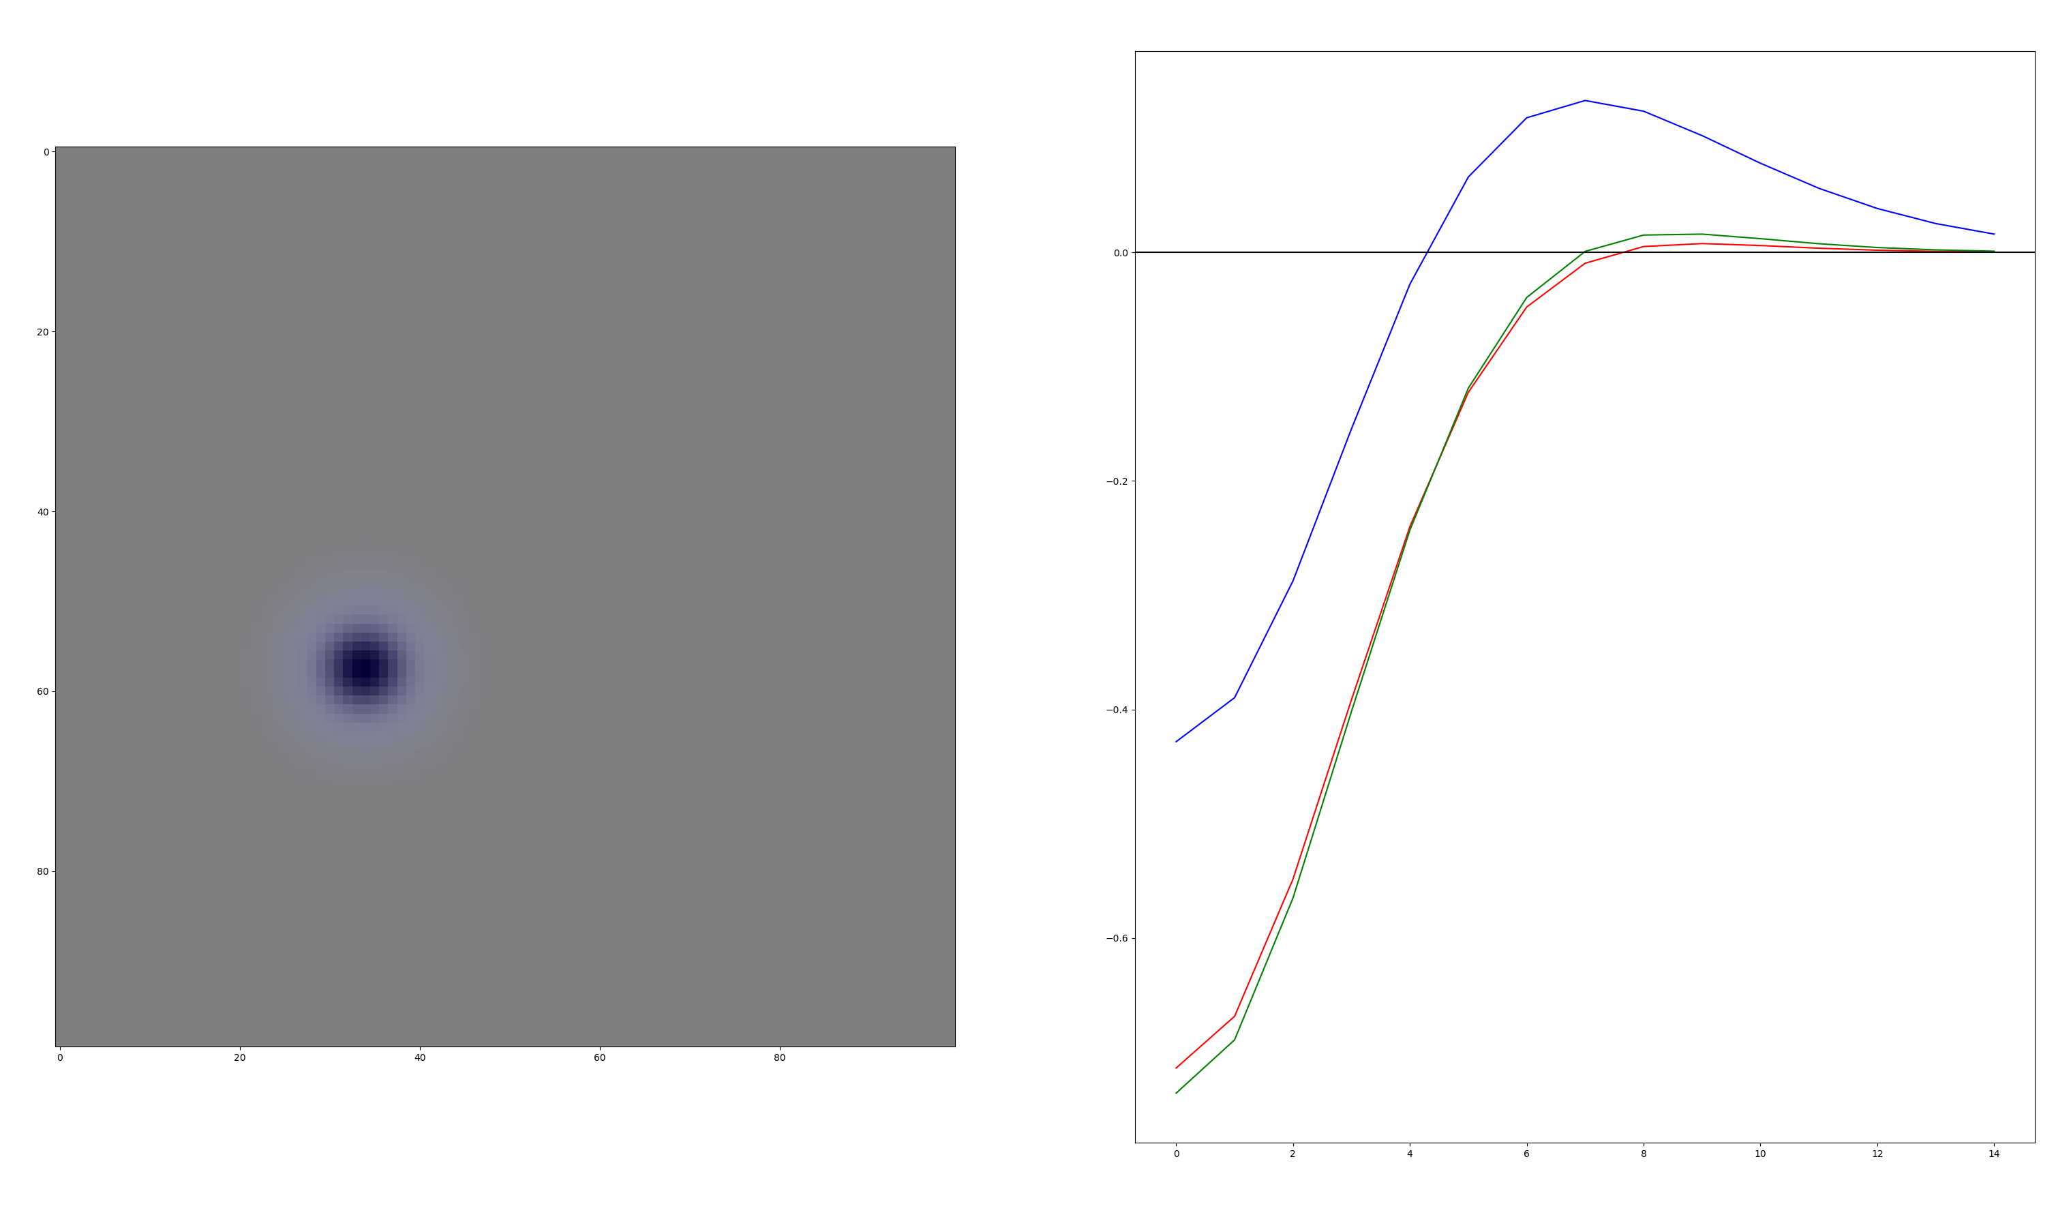
Or even this:

Slide 20
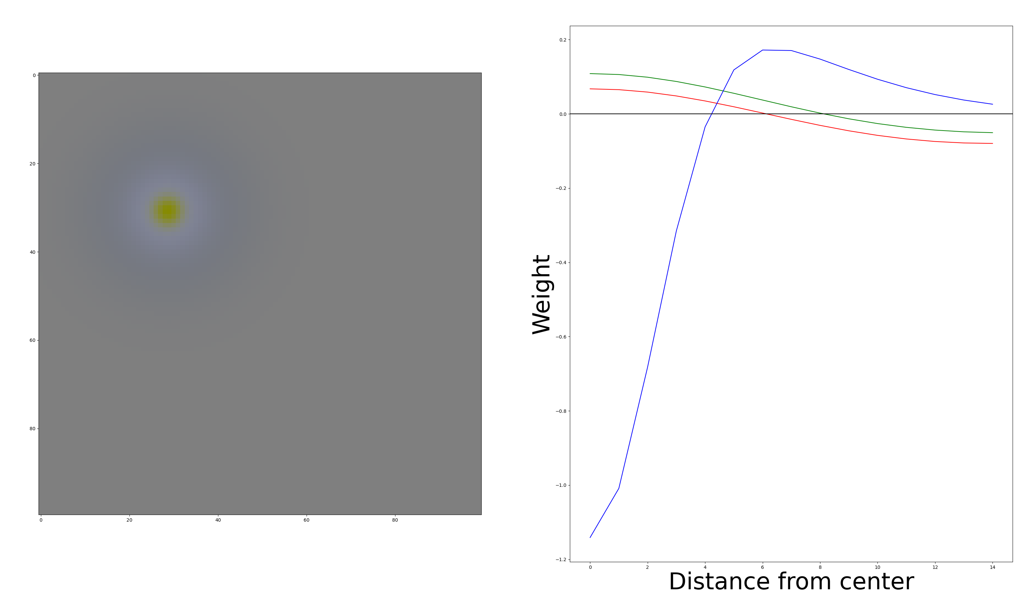
We get only 2 –S RFs: Hypothesis: These might disappear if we get closer to global minimum

Slide 21
What RFs are in each mosaic?
Or how many koniocellular RFs do we get
And are mosaics real

Slide 22
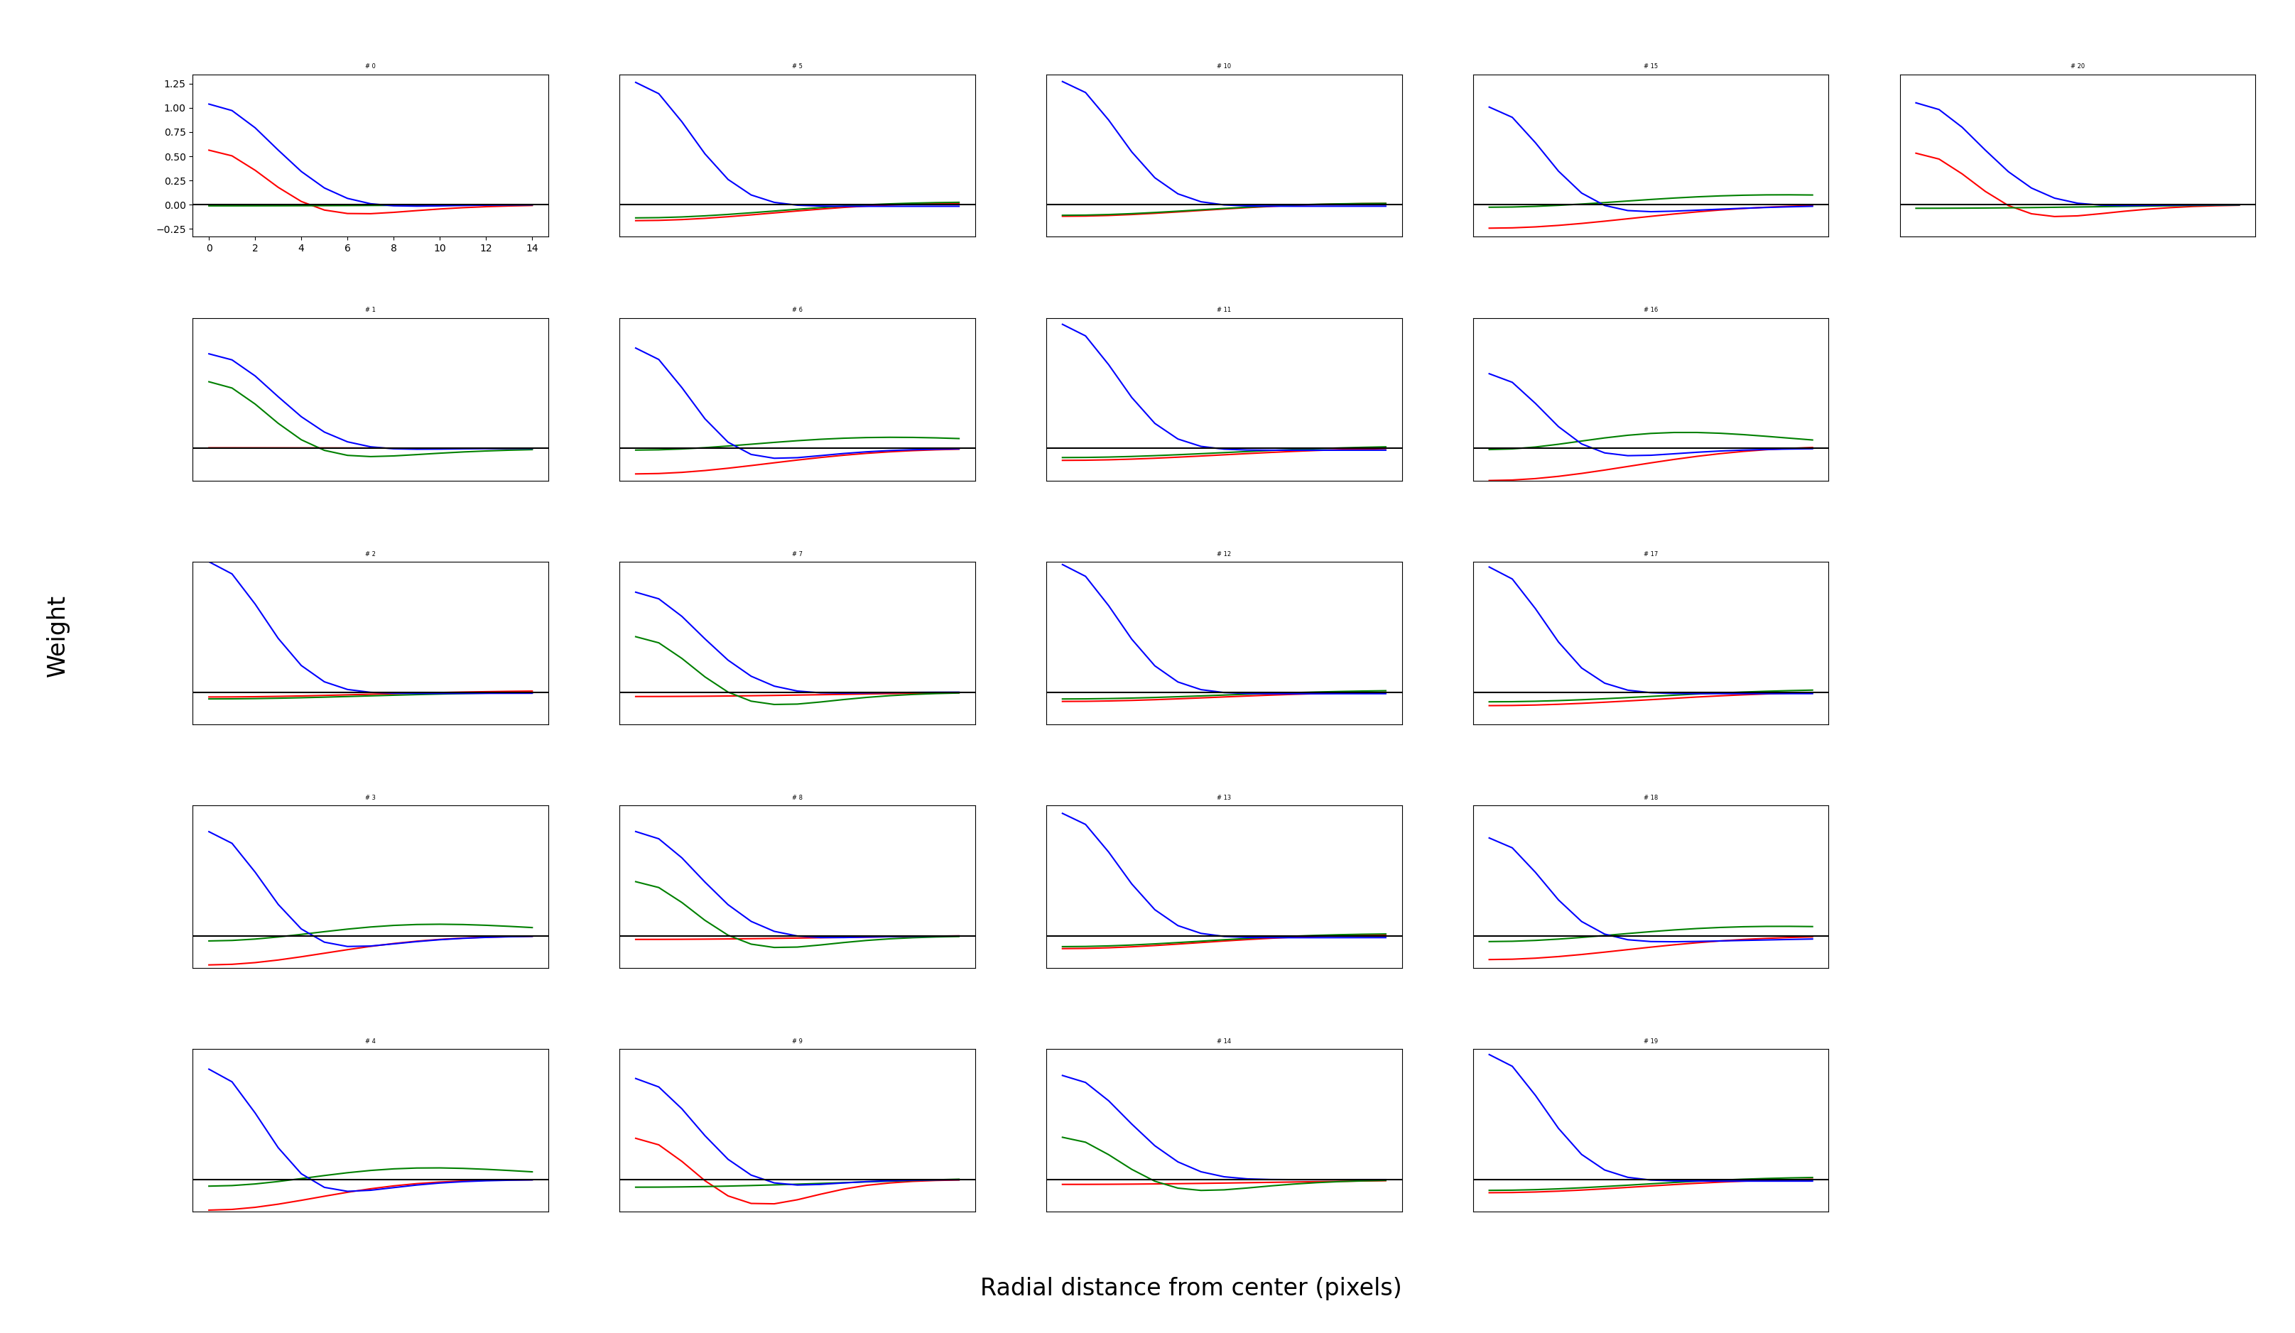
First type (Konio)

Slide 23
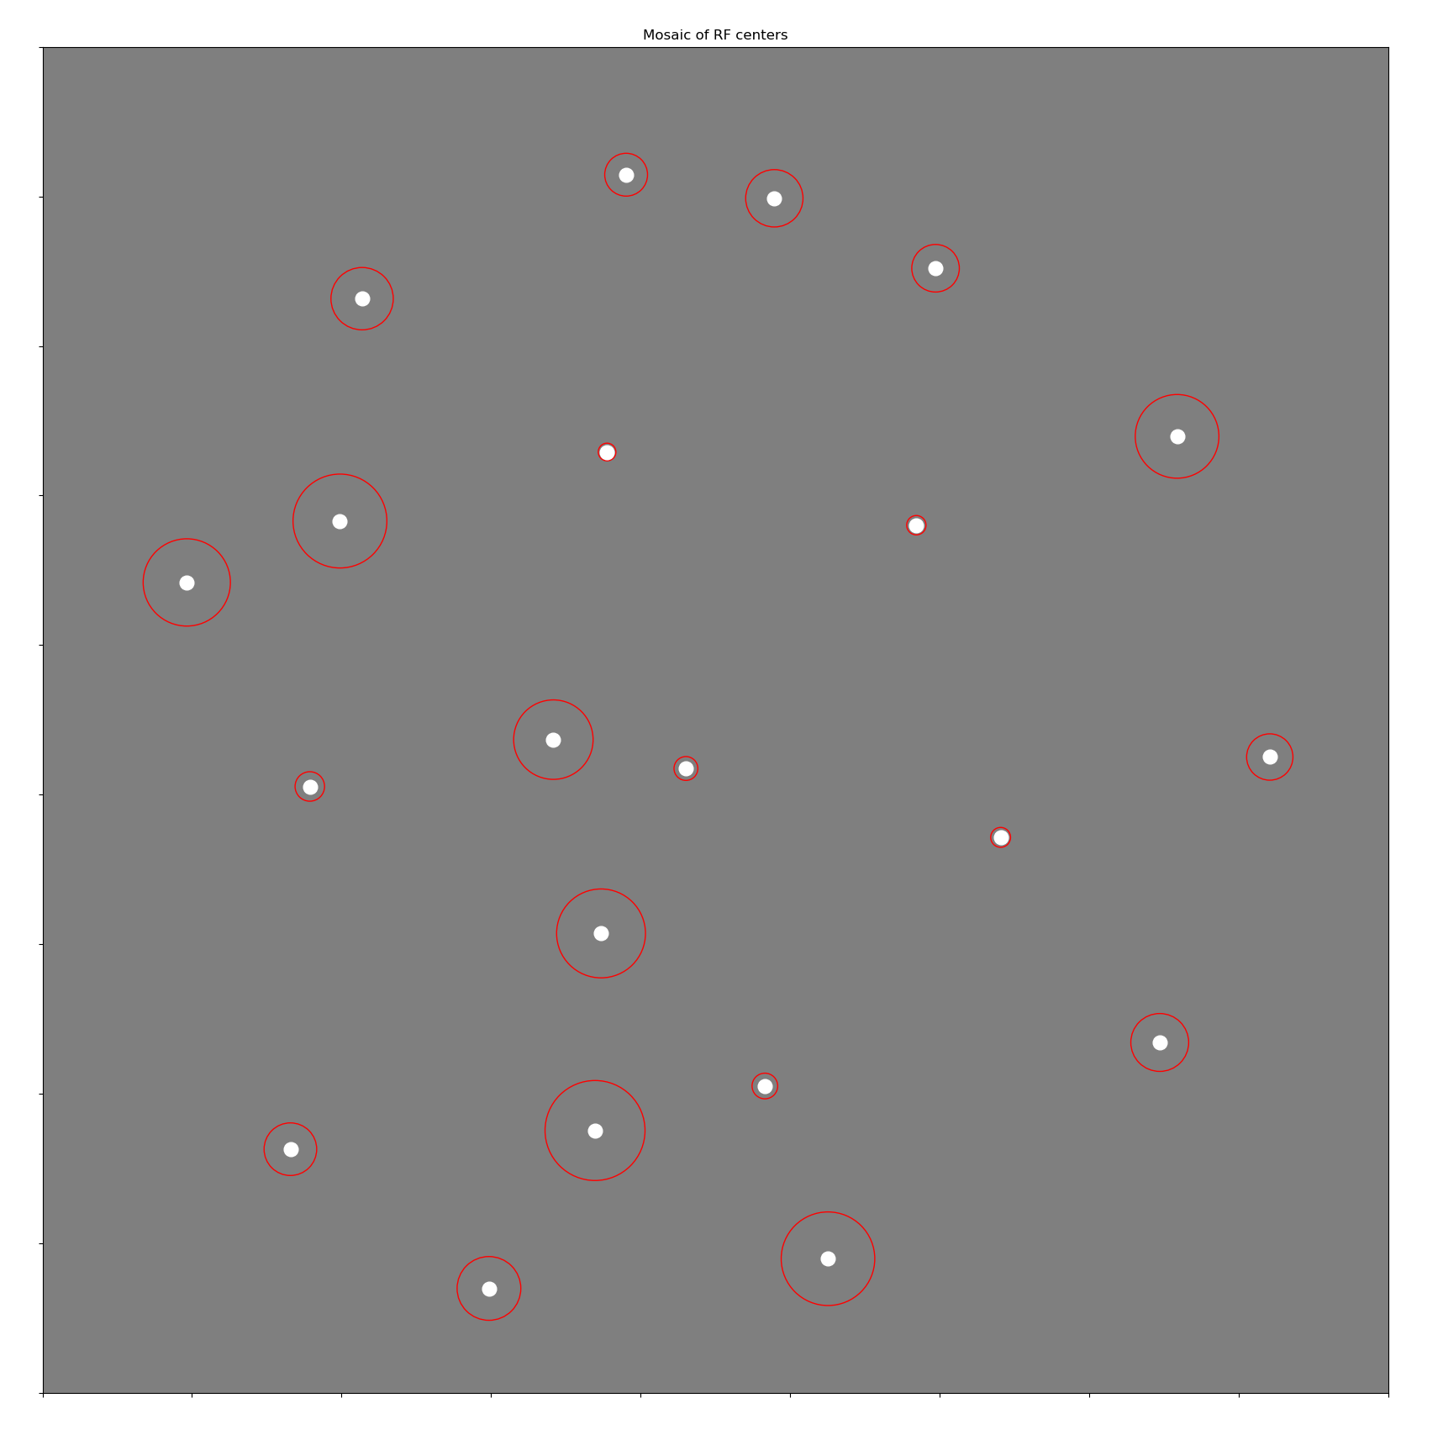
First type (Konio)

Slide 24
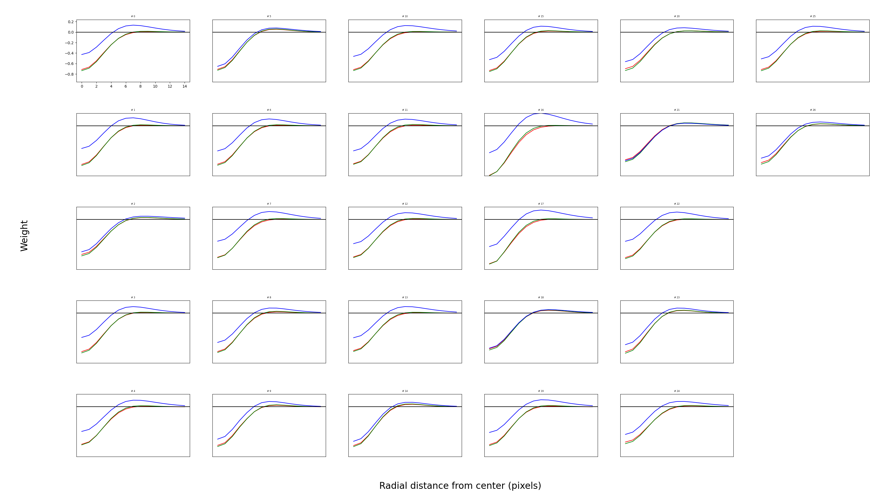
Second type (OFF parvo with –S inputs?)

Slide 25
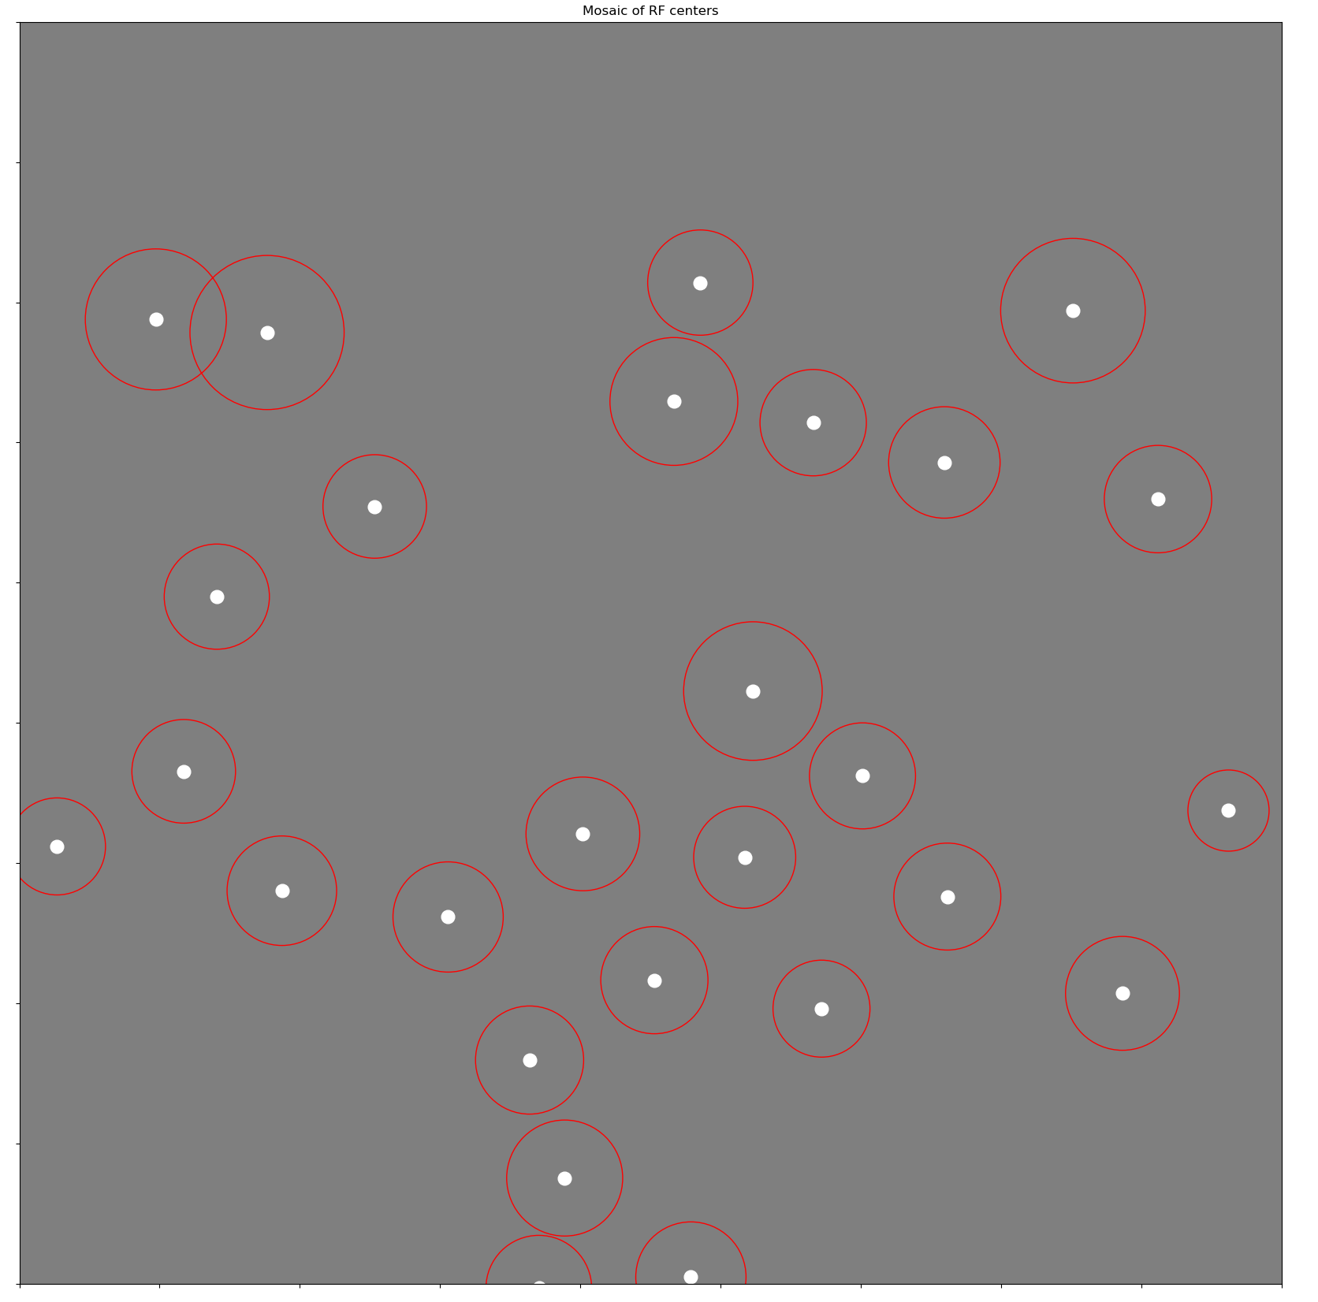
Second type (OFF parvo with –S inputs?)

Slide 26
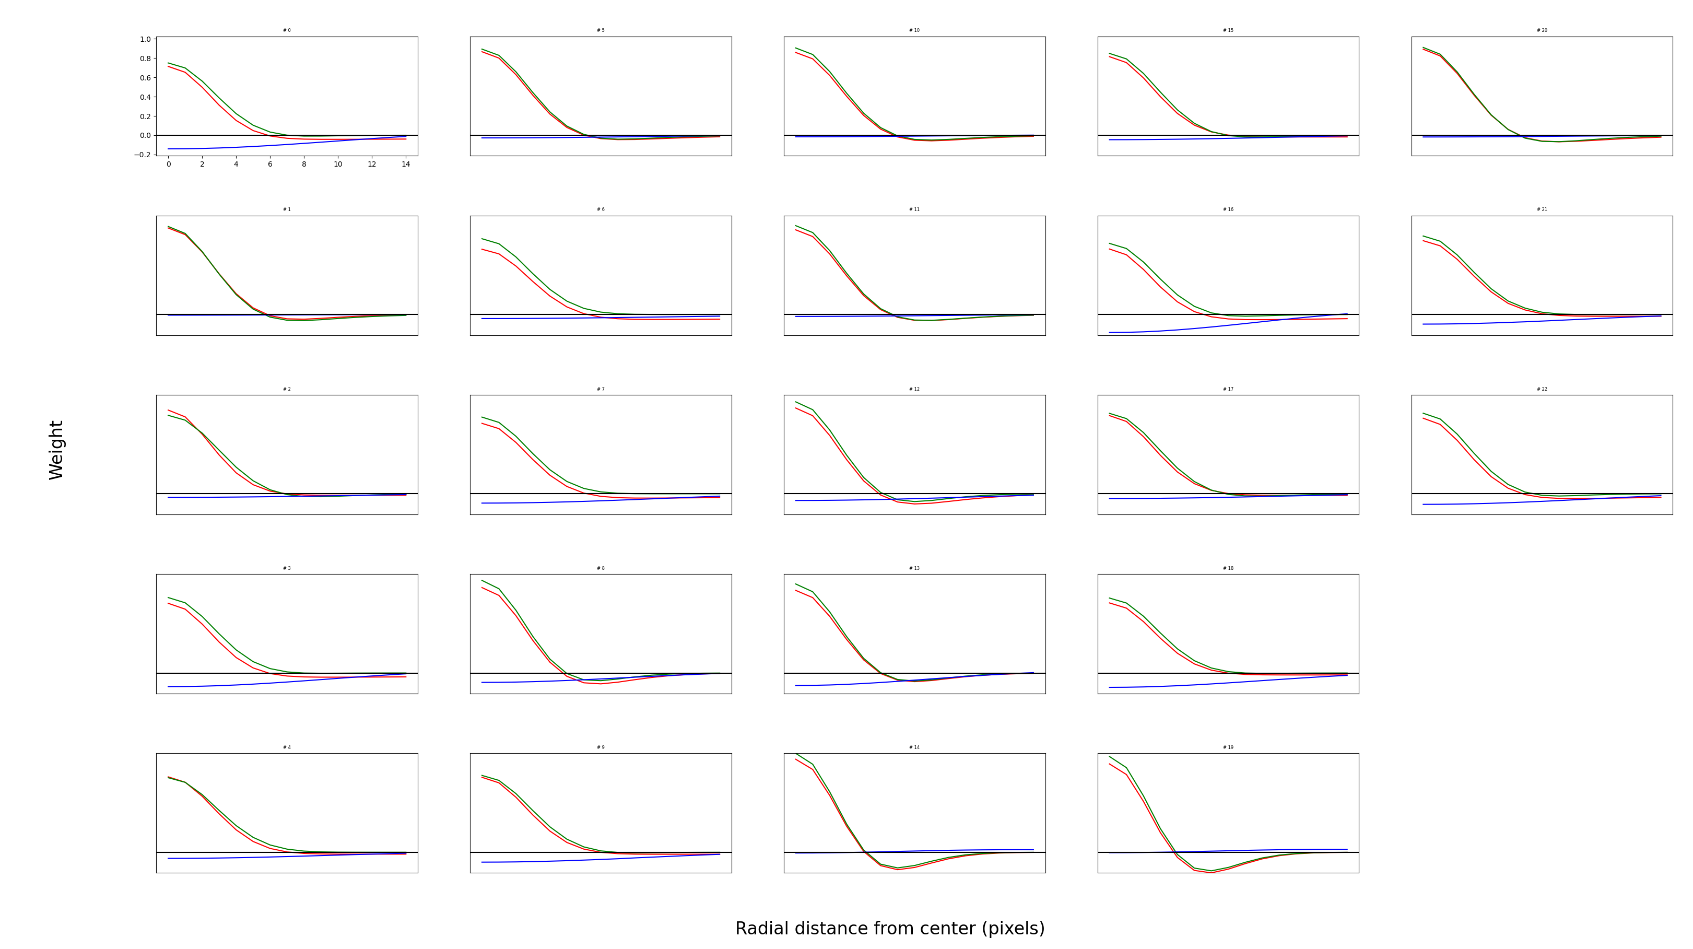
Third type (ON parvo)

Slide 27
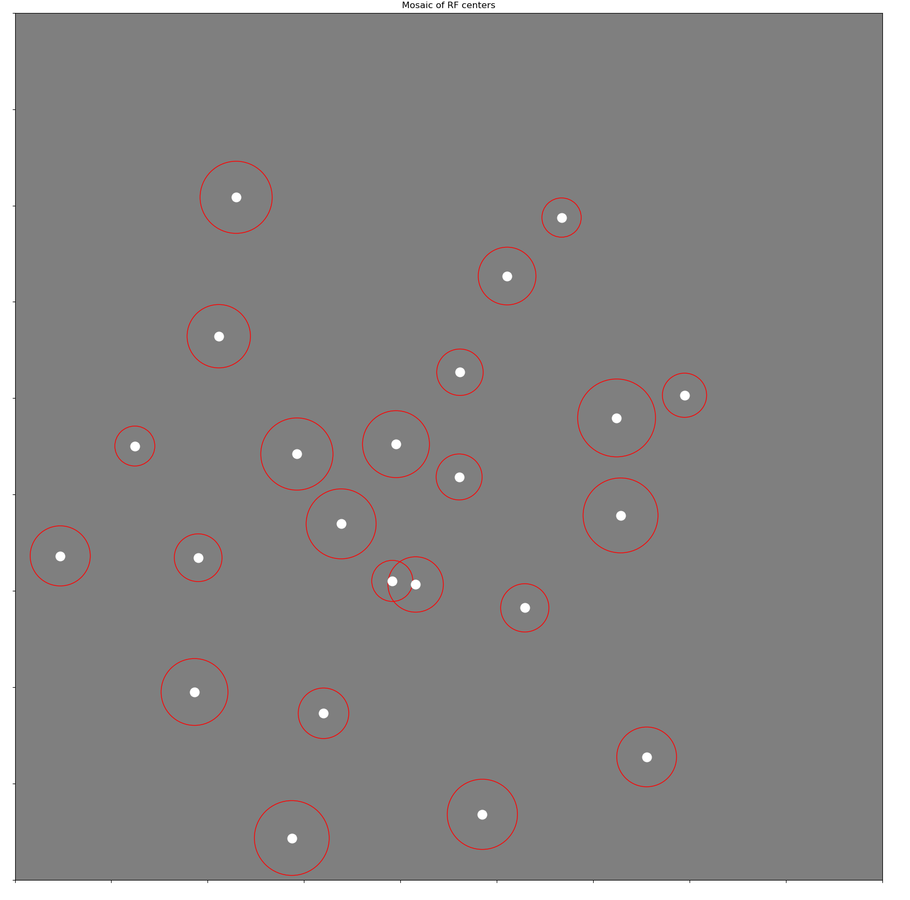
Third type (ON parvo)

Slide 28
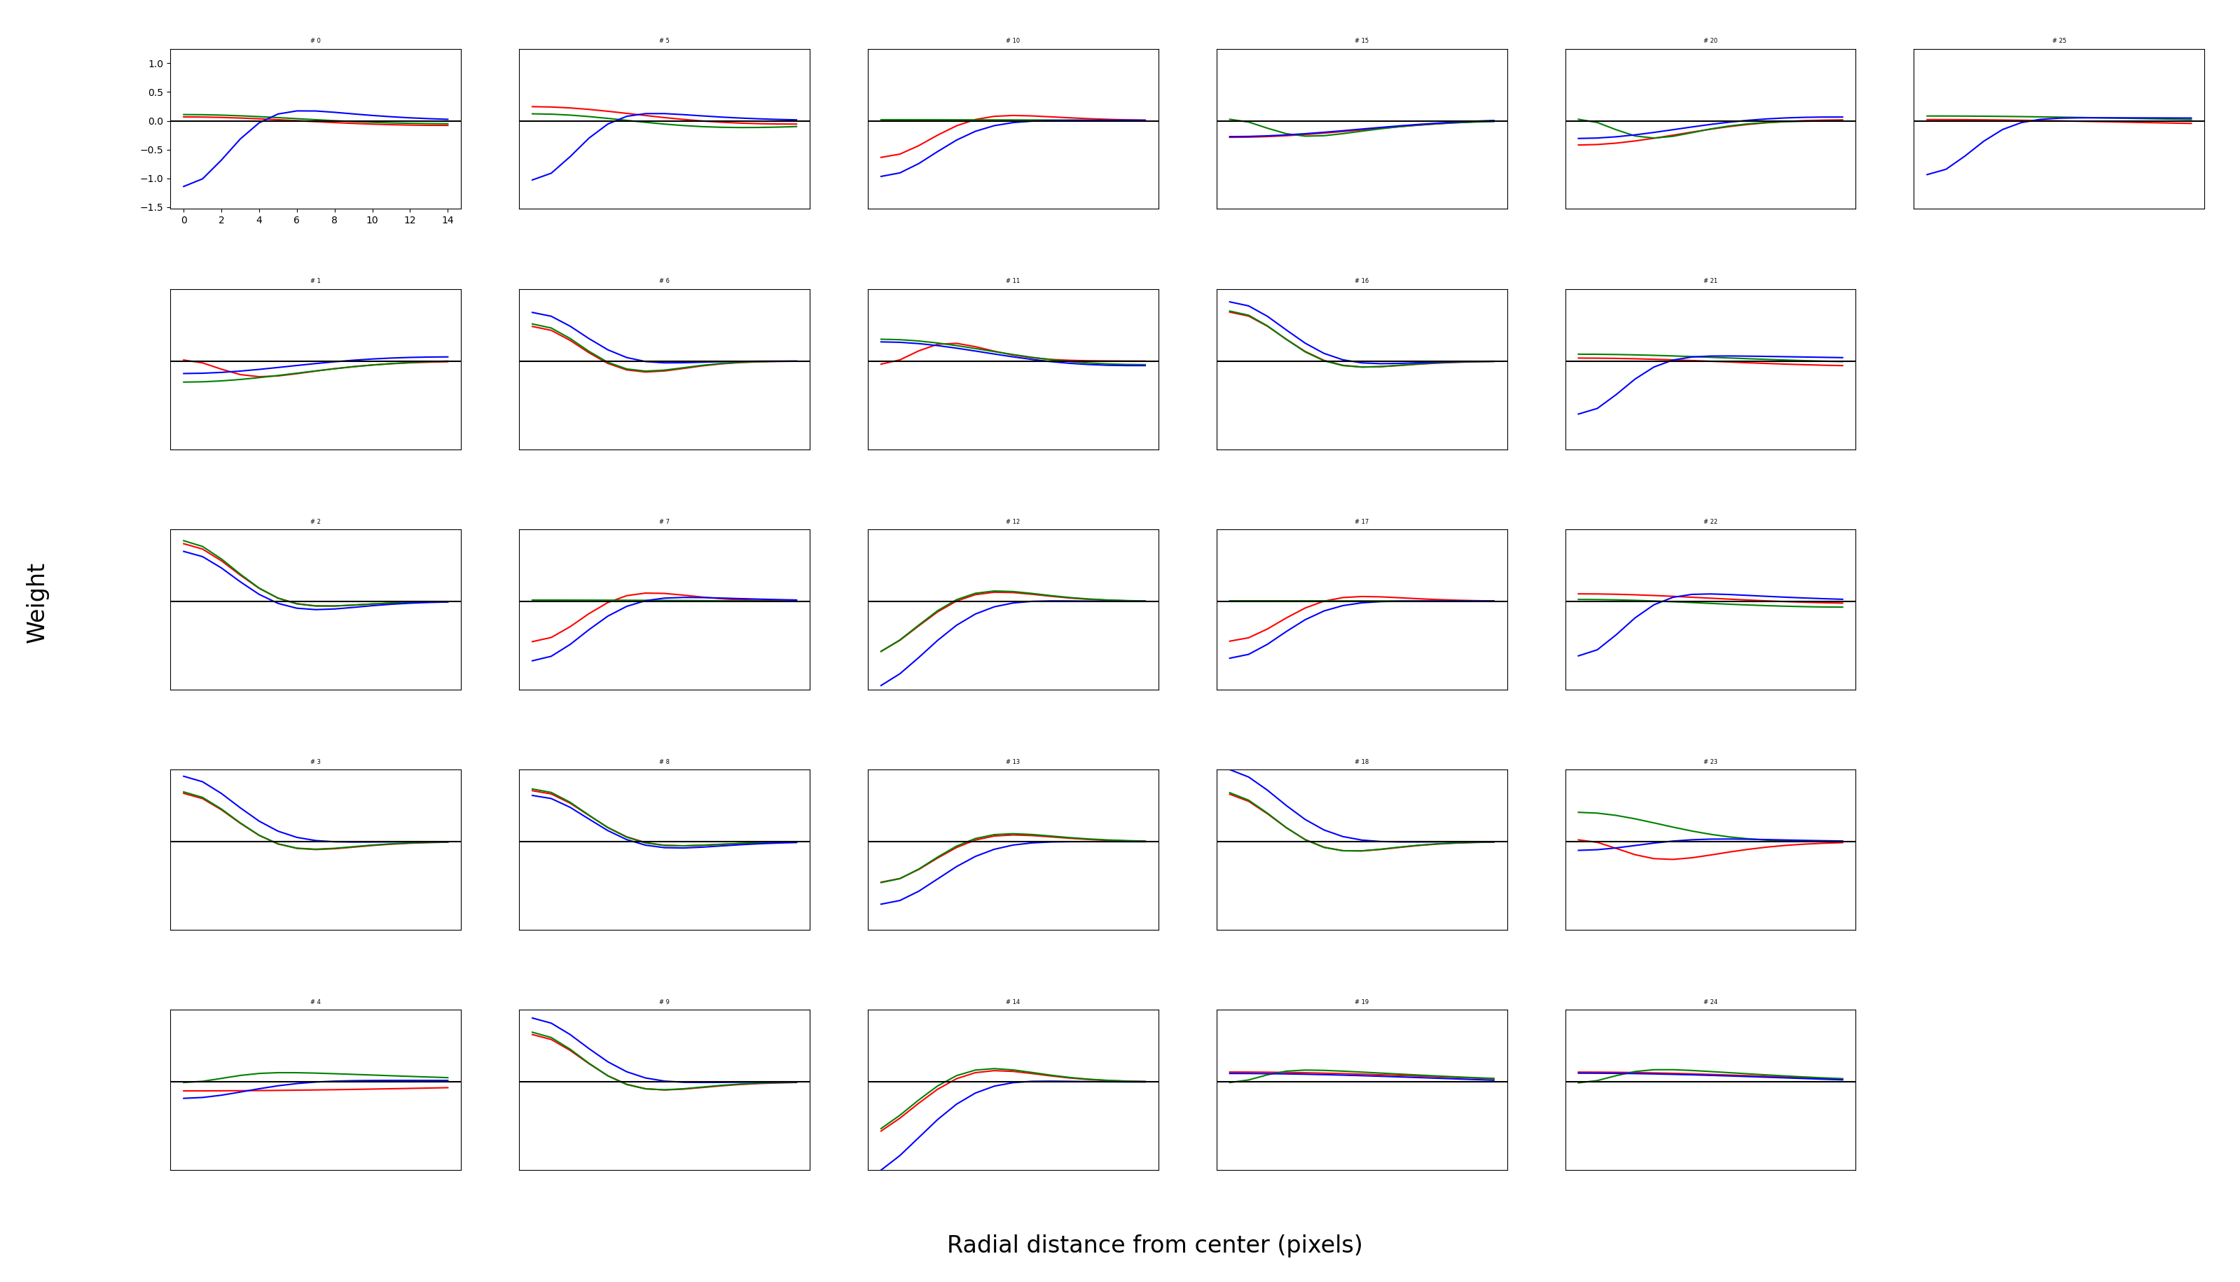
Fourth type (Trash can)

Slide 29
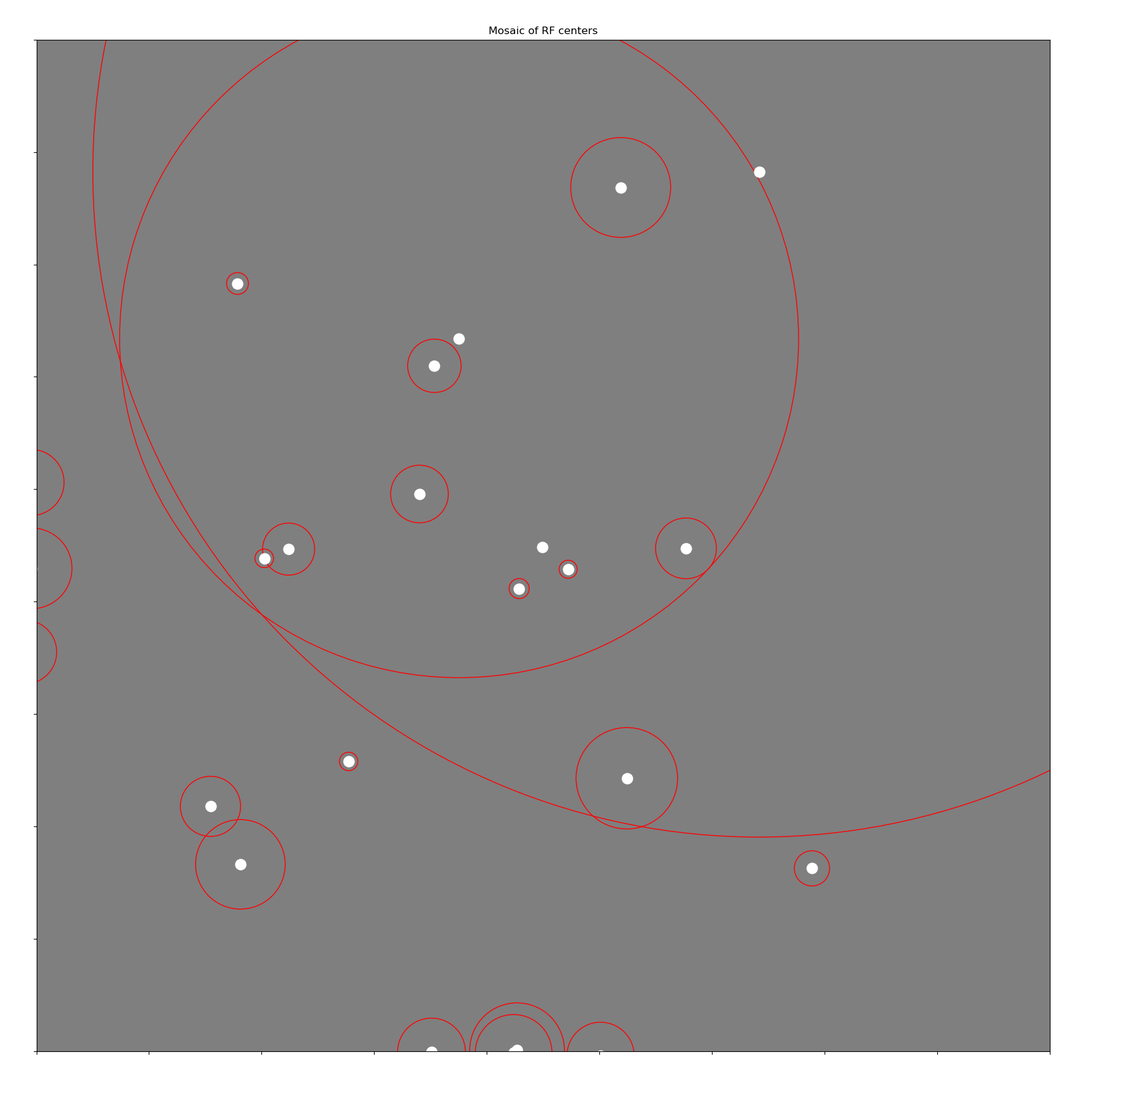
Fourth type (trash can)

Slide 30
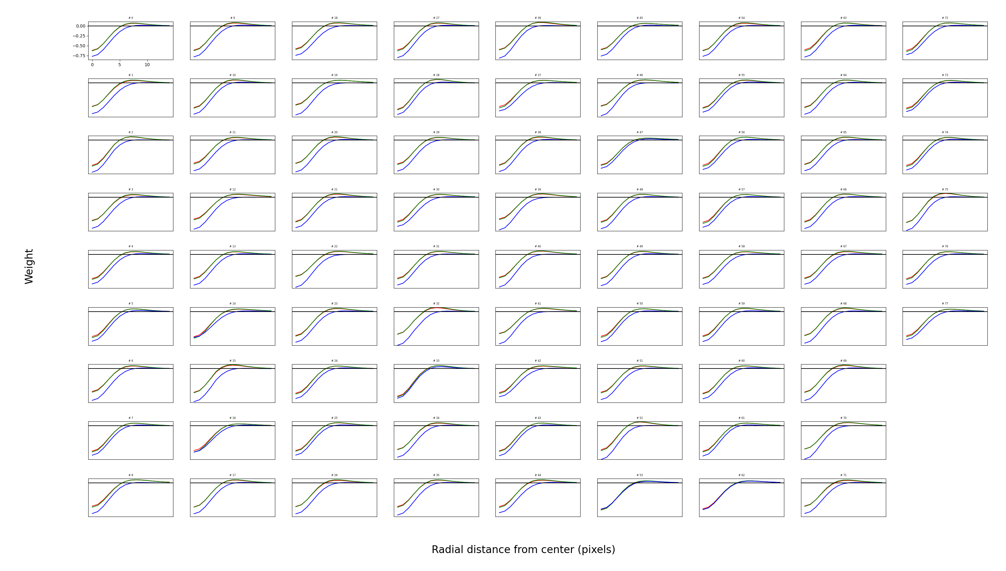
Fifth type (OFF magno)

Slide 31
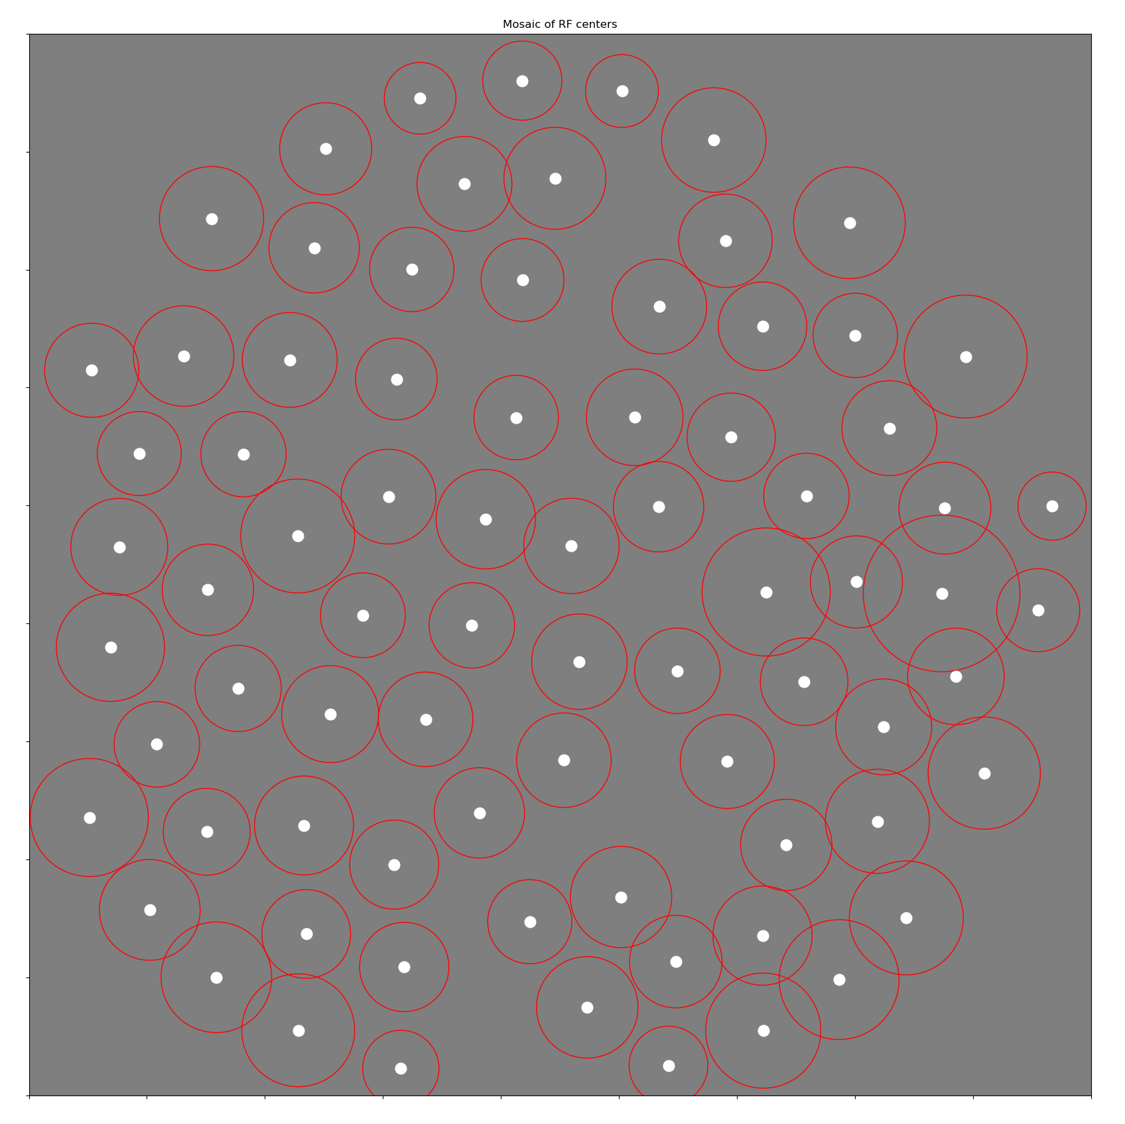
Fifth type (OFF magno)

Slide 32
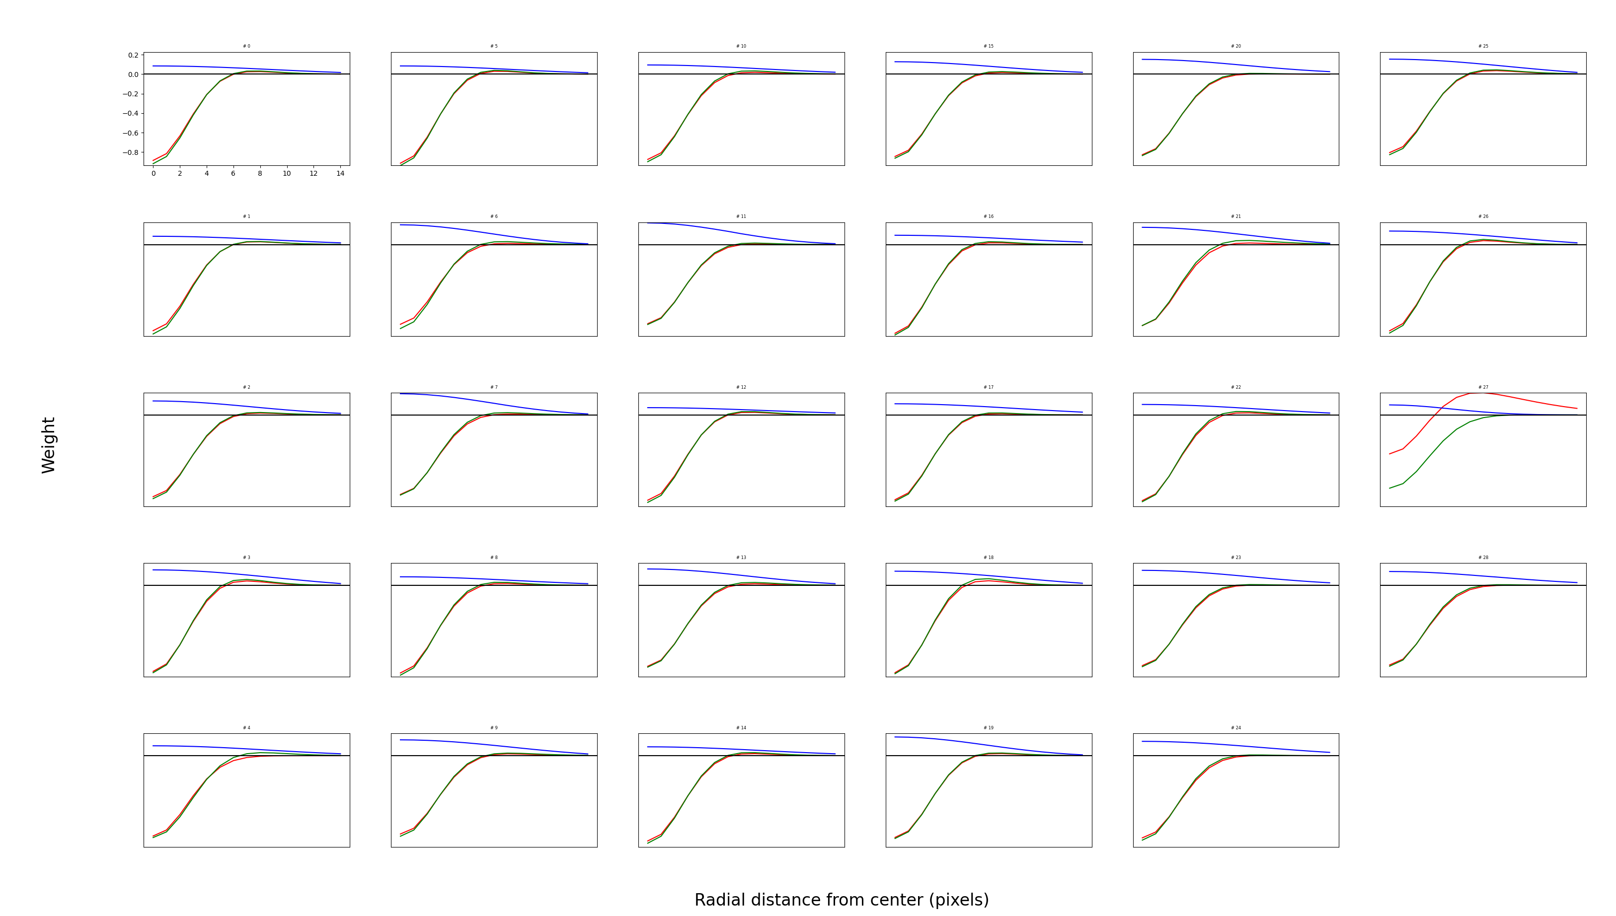
Sixth type (OFF parvo)

Slide 33
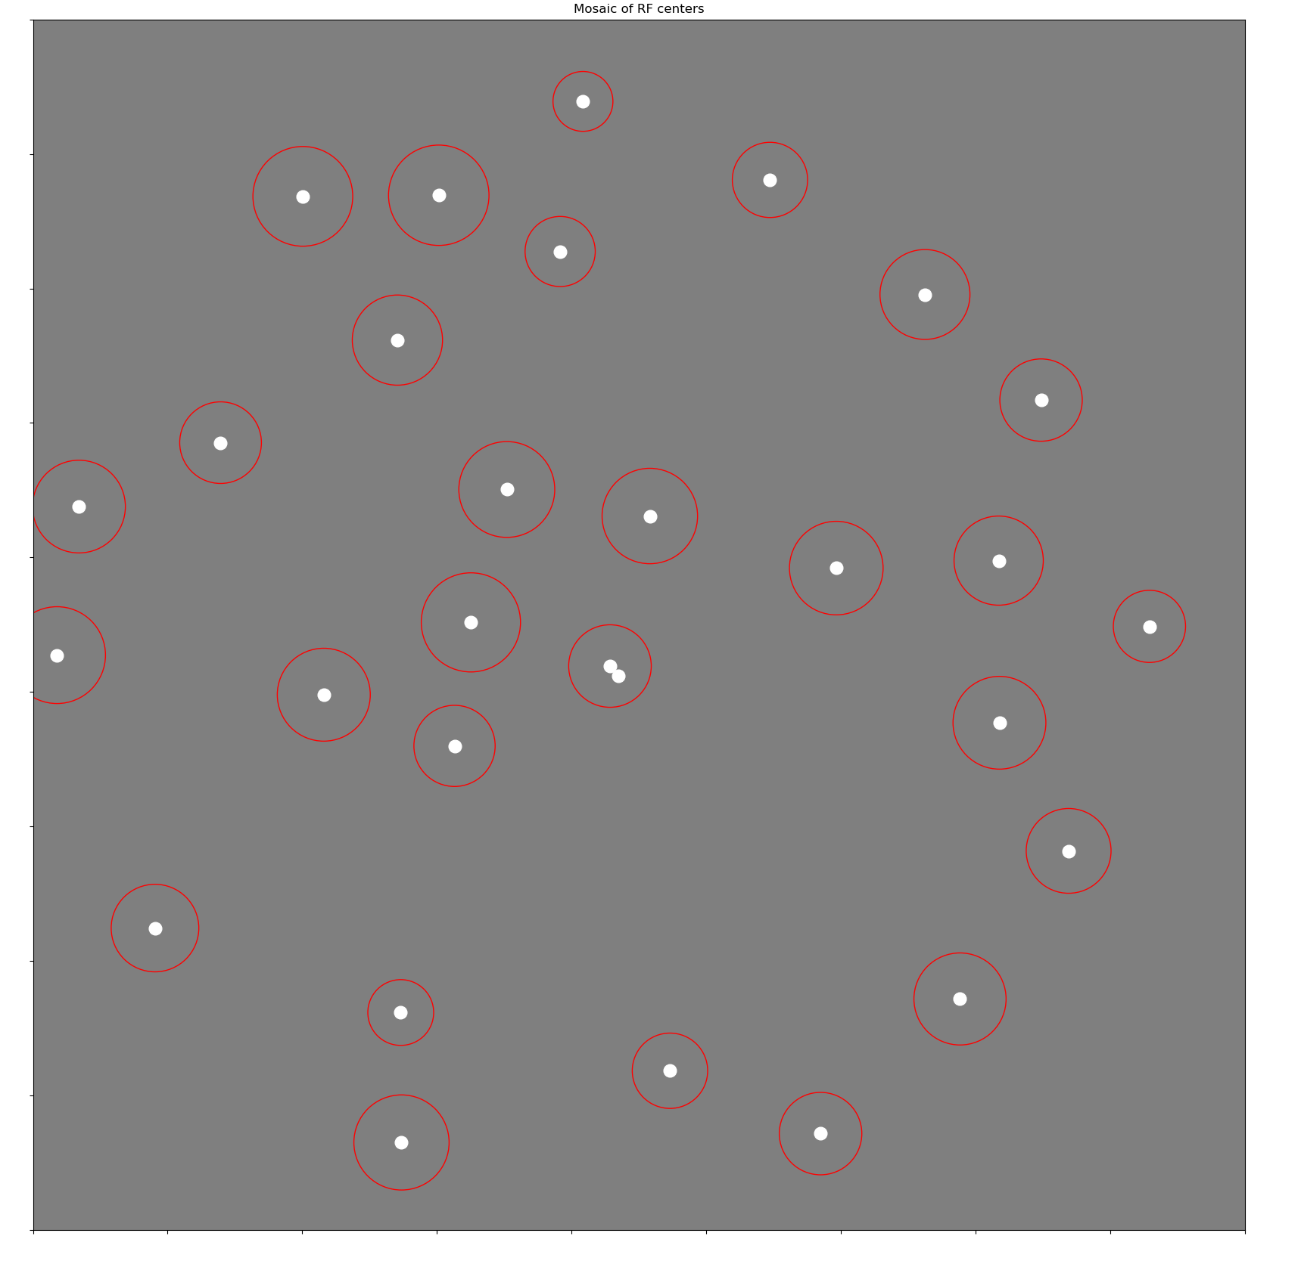
Sixth type (OFF parvo)

Slide 34
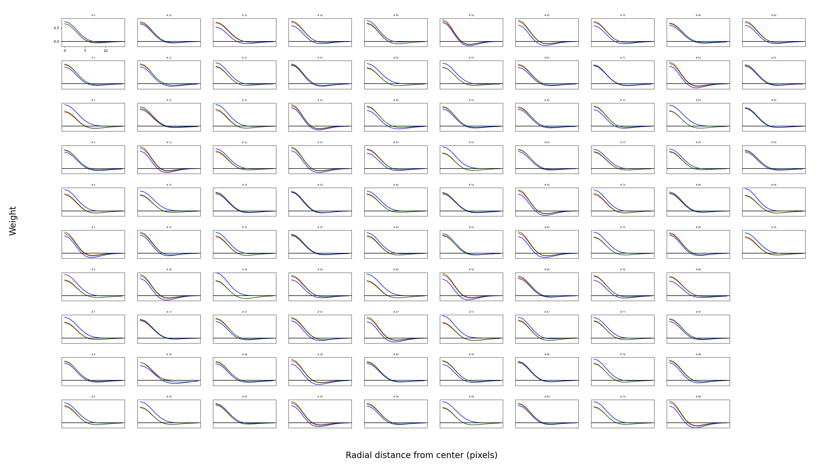
Seventh type (ON magno)

Slide 35
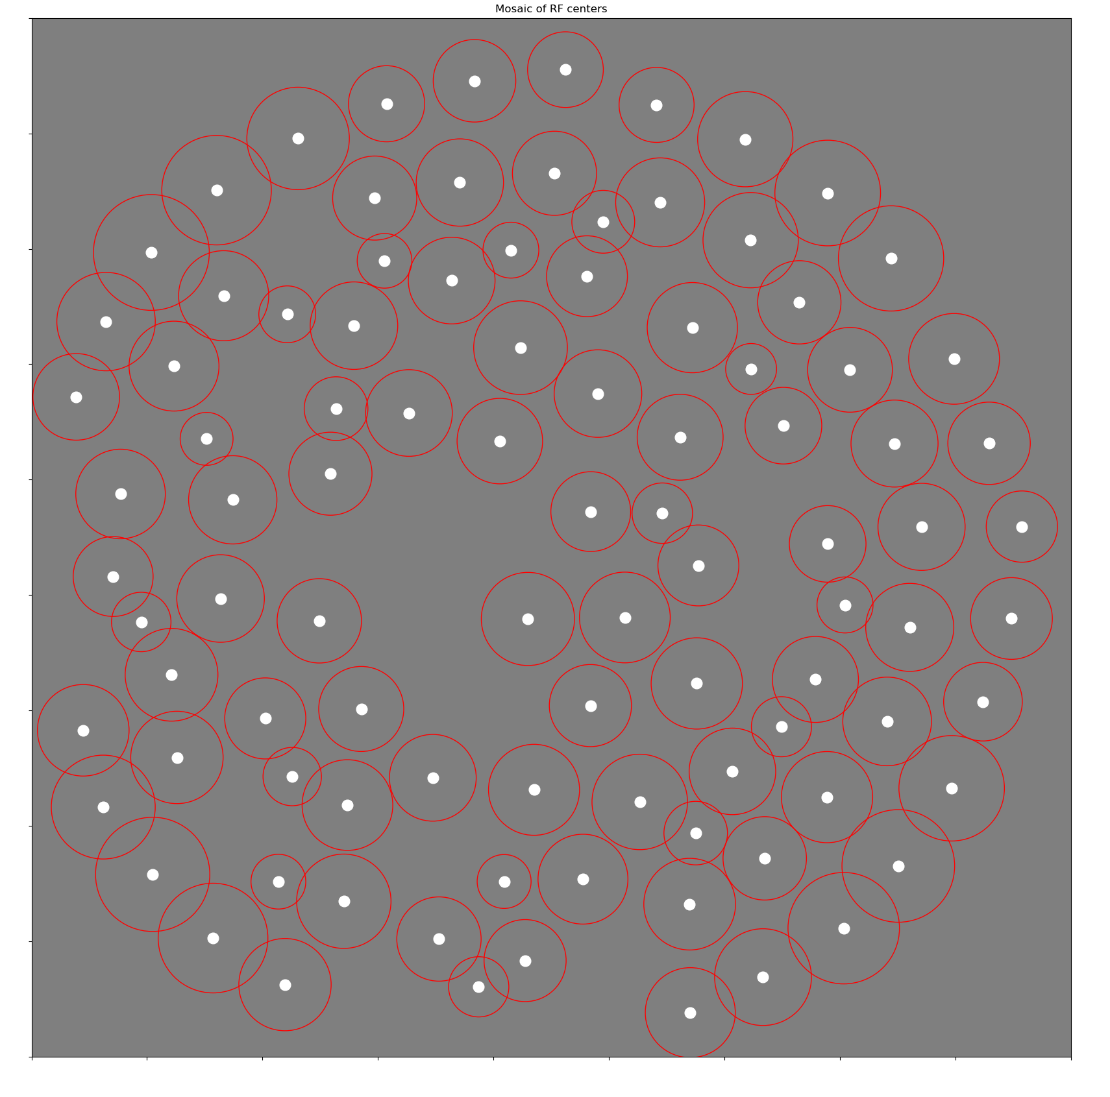
Seventh type (ON magno)

Slide 36
Suggestion
Hypothesis: -S neurons and Trash can neurons contribute less information than the average neuron
MI metric: Remove a single cell from sample and see how much MI decreases.

Slide 37
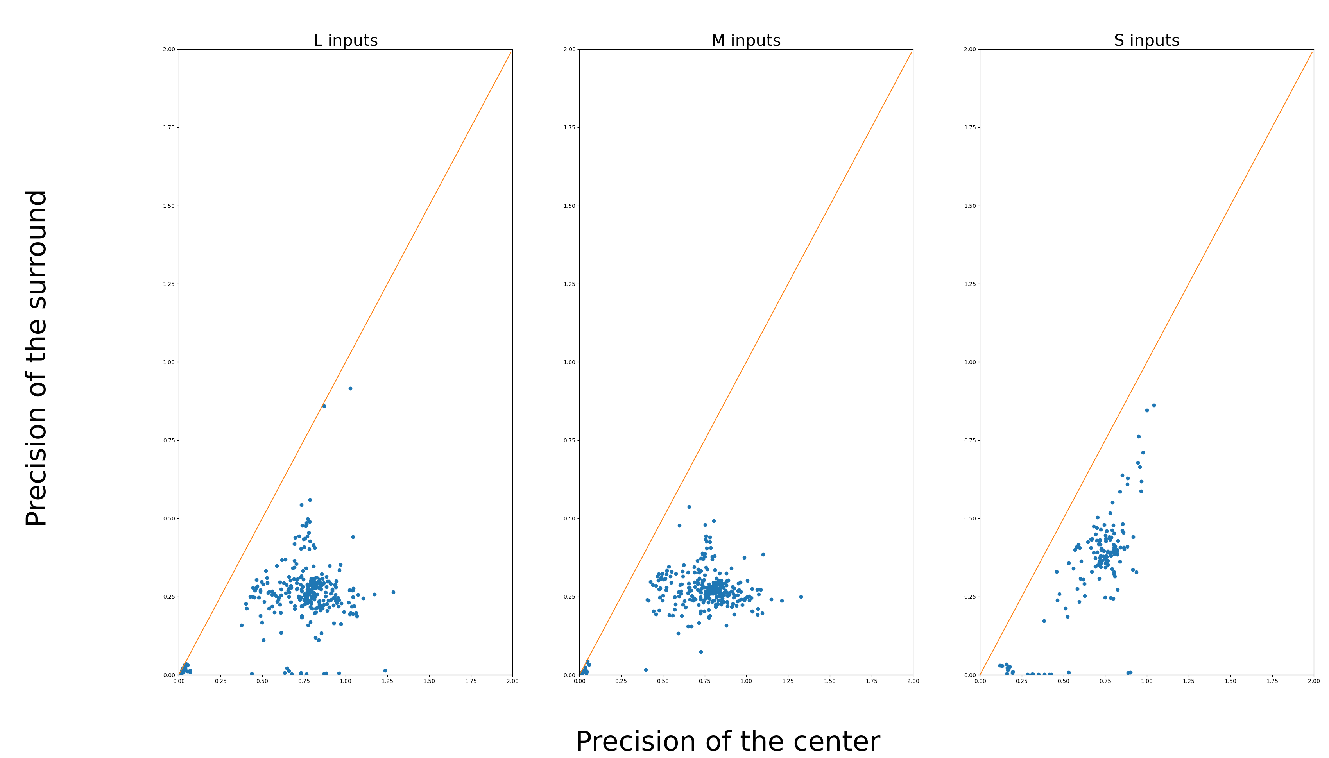
Surround is smaller in S inputs

Slide 38
Reducing Learning rate over epochs

Slide 39
Comments
1. I’ve previously tried the ReduceLROnPlateau function from pytorch
2. I’ve been struggling to make it behave the way I want it to. It tends to reduce LR too often, which can artificially create a plateau.
e.g. Last week, I presented unparametrized RFs that didn’t change much from 1m to 3m epochs. That’s likely because the LR was reduced way too often.
3. I’ve implemented my own version of “ReduceLROnPlateau”, but I ran into the same problems that the pytorch version did. Likely because there is still a plateau after we lower LR.
3. I now reduce LR manually, which allows for consistent behavior and controlled comparisons.

Slide 40
Three experiments
1. LR stays the same (control)
2. LR reduces by 50% every 500k epochs
3. LR reduces by 50% every 1m epochs
Details:
300 neurons, 18x18, DoG parametrization, colors.

Slide 41
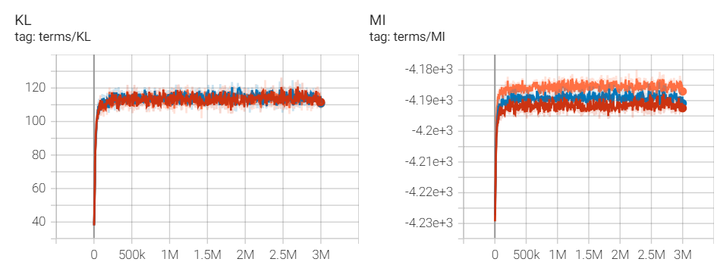
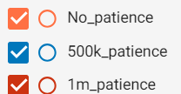
Go to tensorboard for updated version

Slide 42
Next week
Check if reducing LR improves mosaics
Look more closely at unparametrized mosaics, with DoG fits
Fix Tensorboard bug with the covariance matrices
Exam and lab meeting presentation

